Slide 1
Opal Gemstone
Jewelry In 14K Gold
Presented By

Slide 2
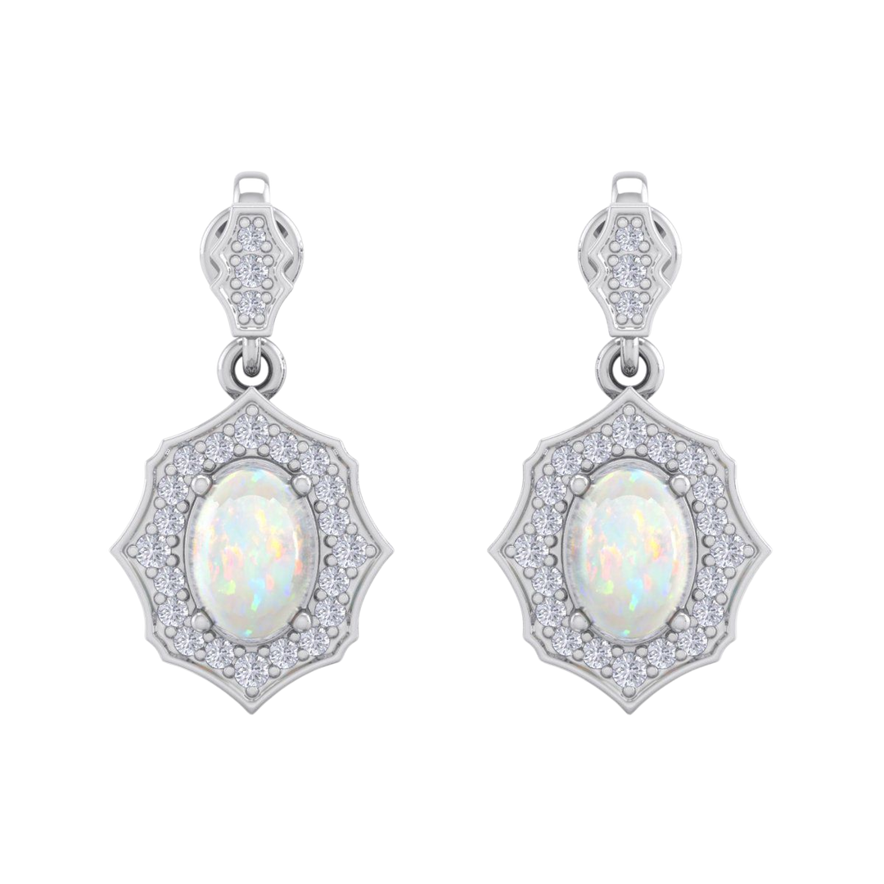
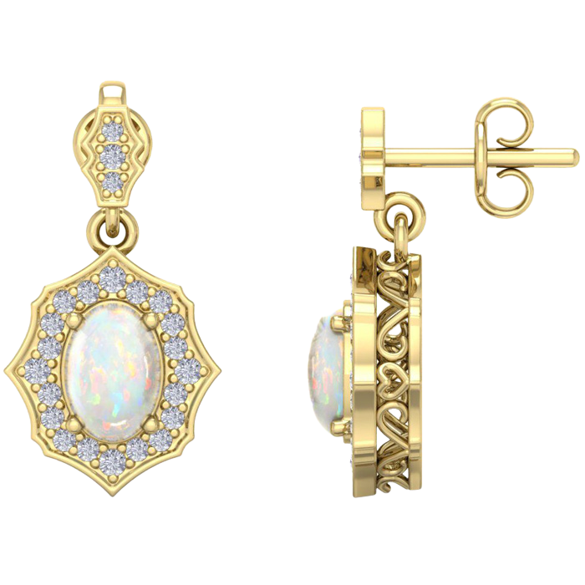
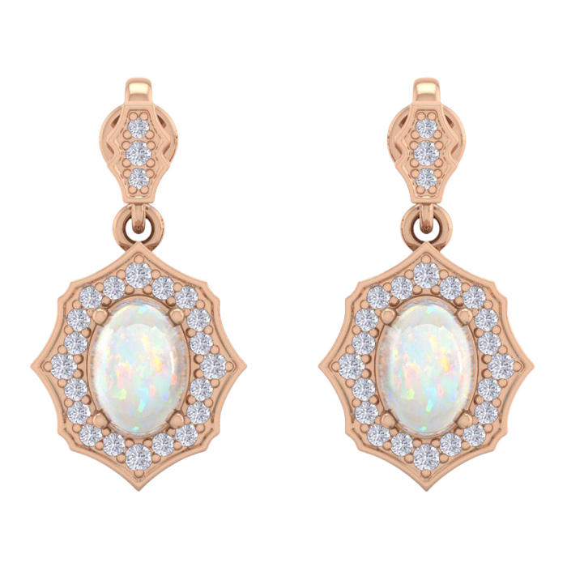
7 X 5 MM Opal & Diamond
Earrings
H071906
METALS: 14K WG, YG, RG
DIAMOND QUALITY: (I-J, I1)
DIAMOND WEIGHT: 1/4 CTW
WHOLESALE
$500
1

Slide 3
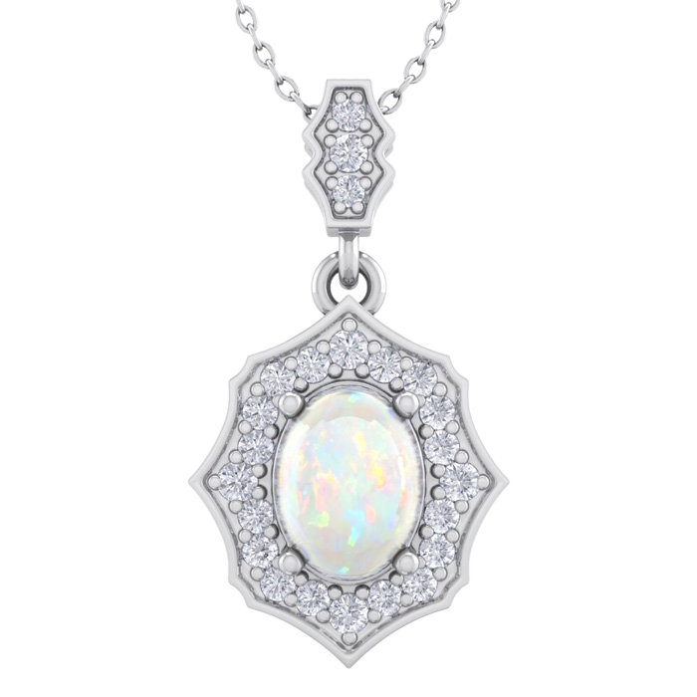
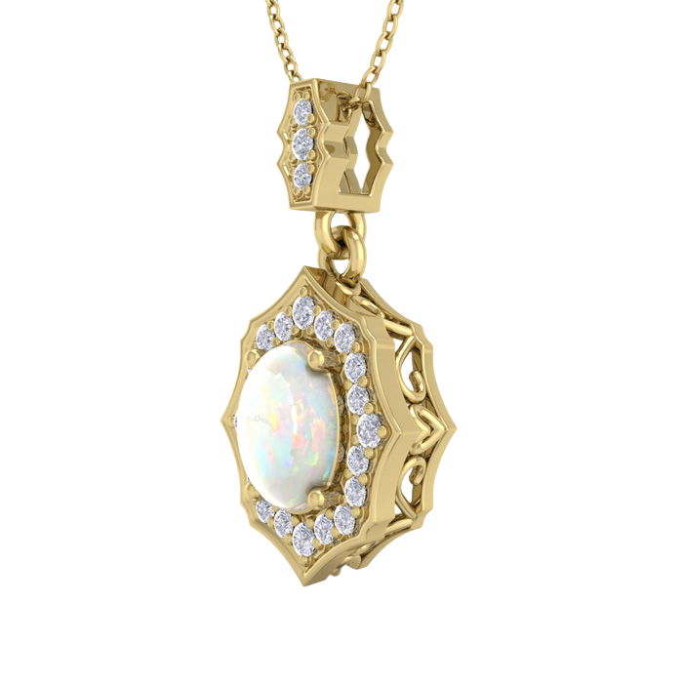
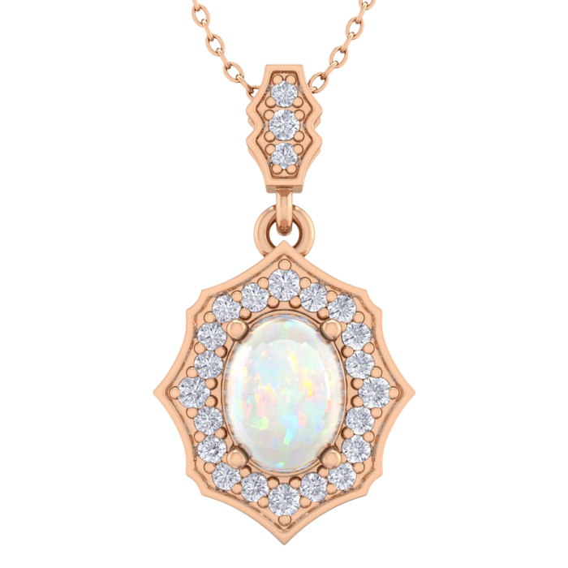
8 X 6 MM Opal & Diamond
Pendant
H081903
METALS: 14K WG, YG, RG
DIAMOND QUALITY: (I-J, I1)
DIAMOND WEIGHT: 1/4 CTW
WHOLESALE
$480
18" Chain Included
2

Slide 4
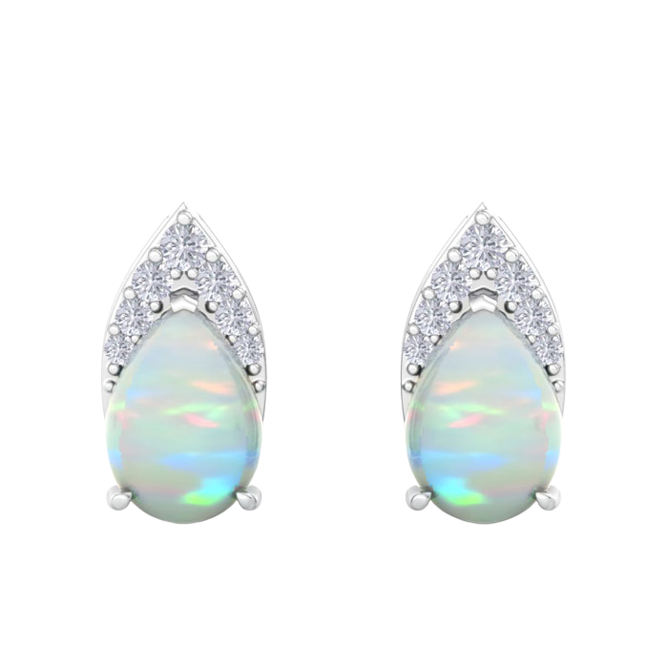
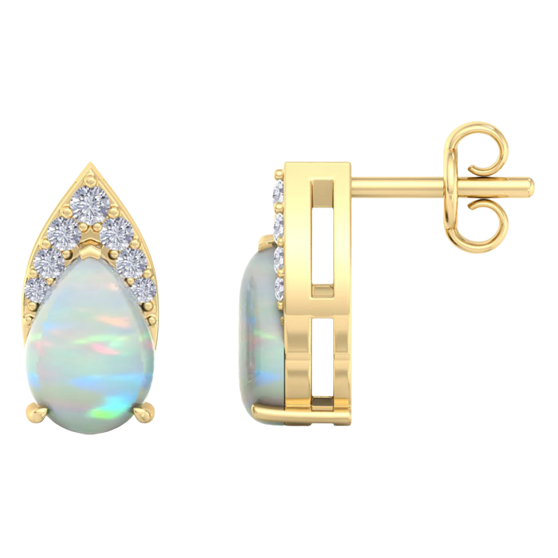
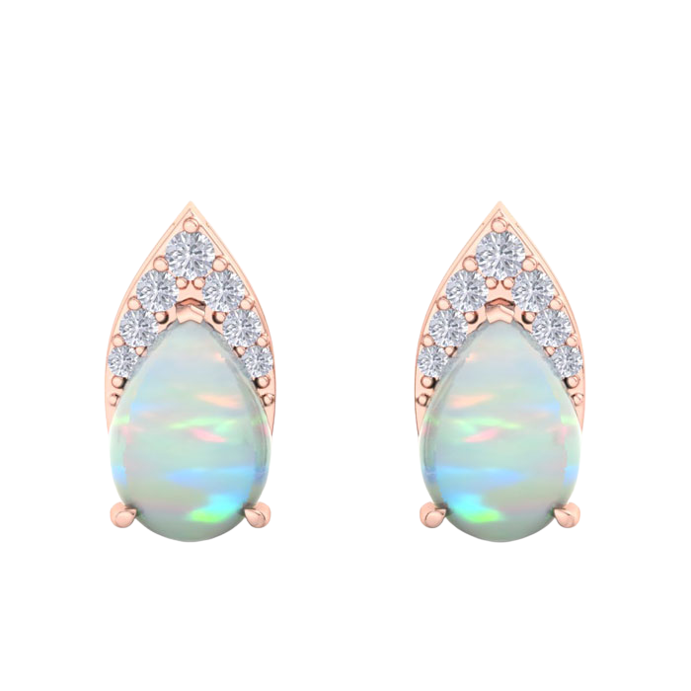
7 X 5 MM Opal & Diamond
Earrings
H042213
METALS: 14K WG, YG, RG
DIAMOND QUALITY: (I-J, I1)
DIAMOND WEIGHT: 1/5 CTW
WHOLESALE
$325
3

Slide 5
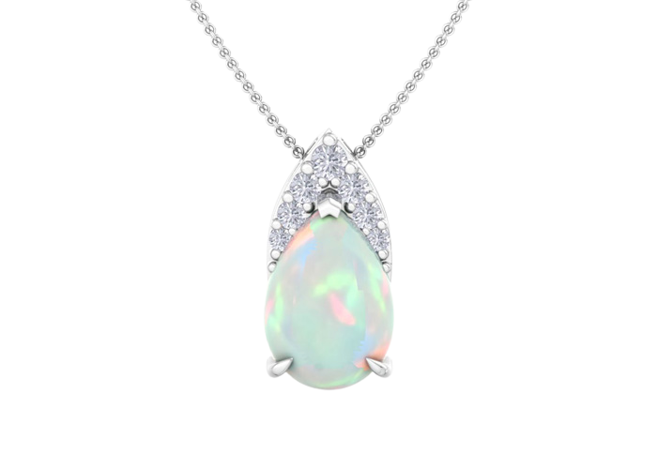
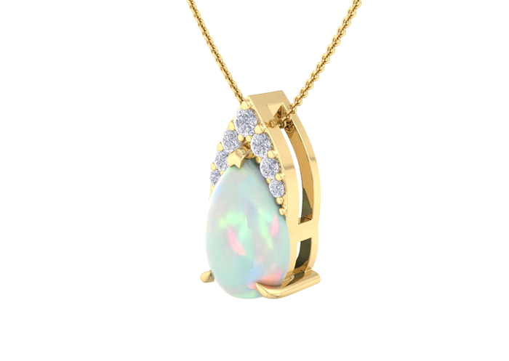
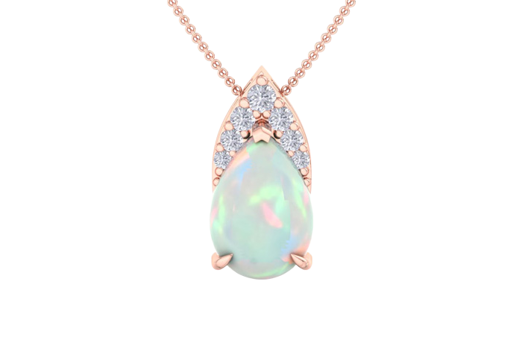
7 X 5 MM Opal & Diamond
Pendant
H042212
METALS: 14K WG, YG, RG
DIAMOND QUALITY: (I-J, I1)
DIAMOND WEIGHT: 1/10 CTW
WHOLESALE
$215
18" Chain Included
4

Slide 6
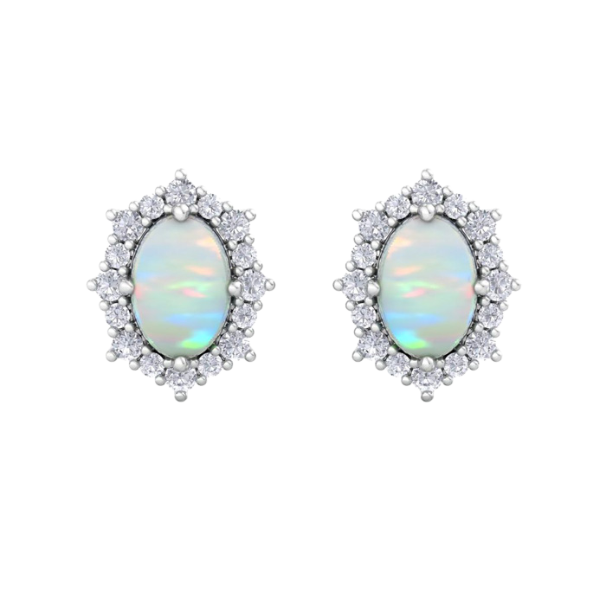
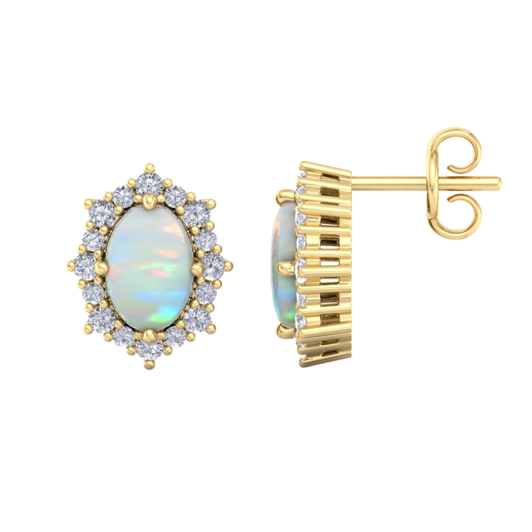
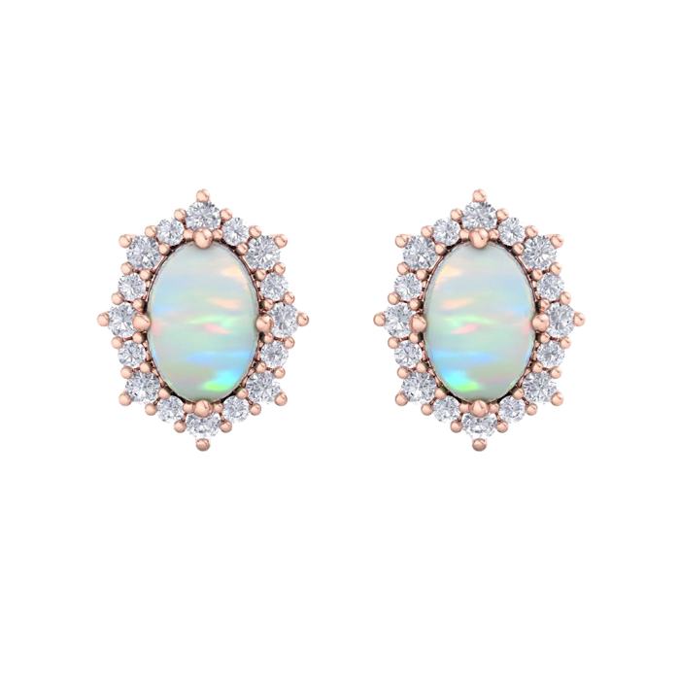
7 X 5 MM Opal & Diamond
Earrings
H062205
METALS: 14K WG, YG, RG
DIAMOND QUALITY: (I-J, I1)
DIAMOND WEIGHT: 1/2 CTW
WHOLESALE
$465
5

Slide 7
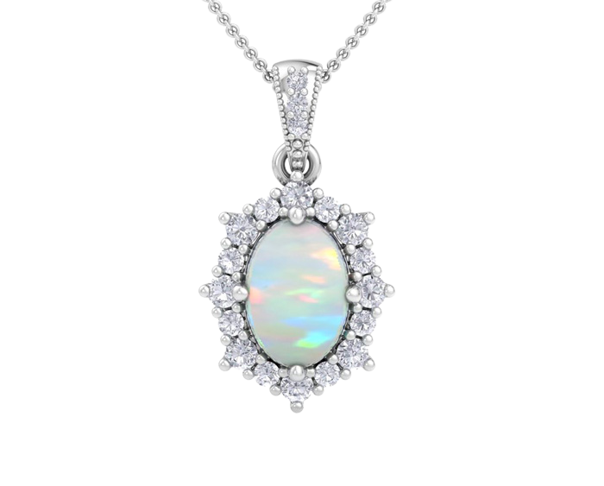
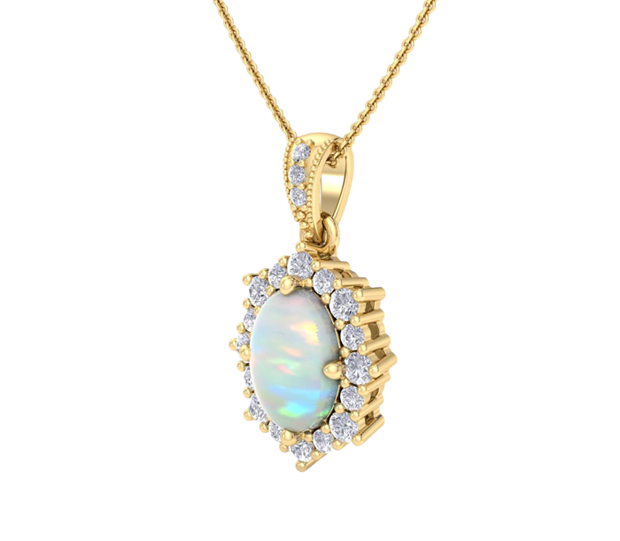
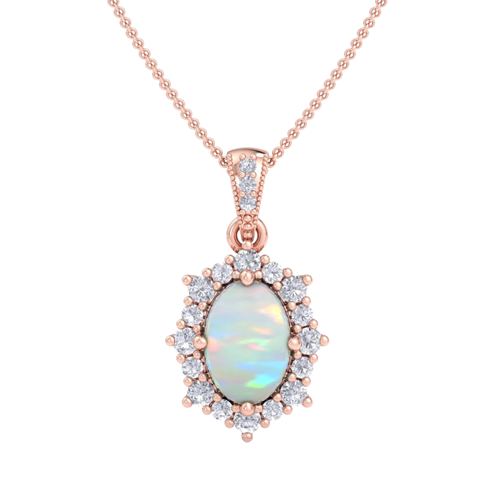
8 X 6 MM Opal & Diamond
Pendant
H062206
METALS: 14K WG, YG, RG
DIAMOND QUALITY: (I-J, I1)
DIAMOND WEIGHT: 1/3 CTW
WHOLESALE
$385
18" Chain Included
6

Slide 8
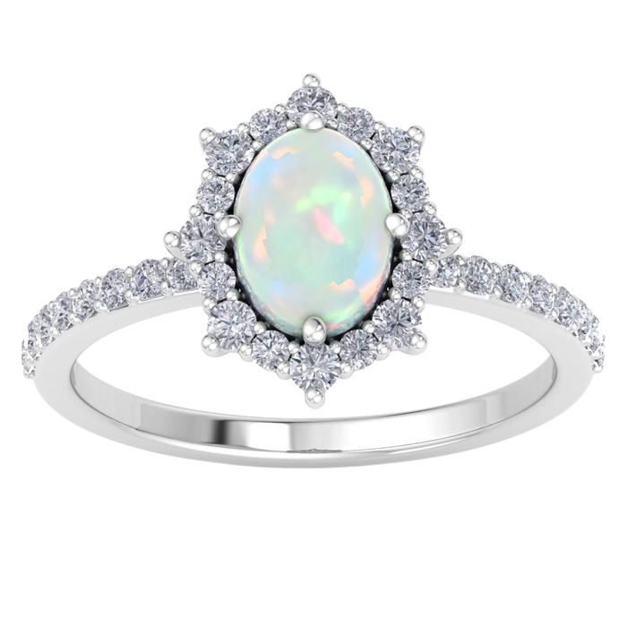
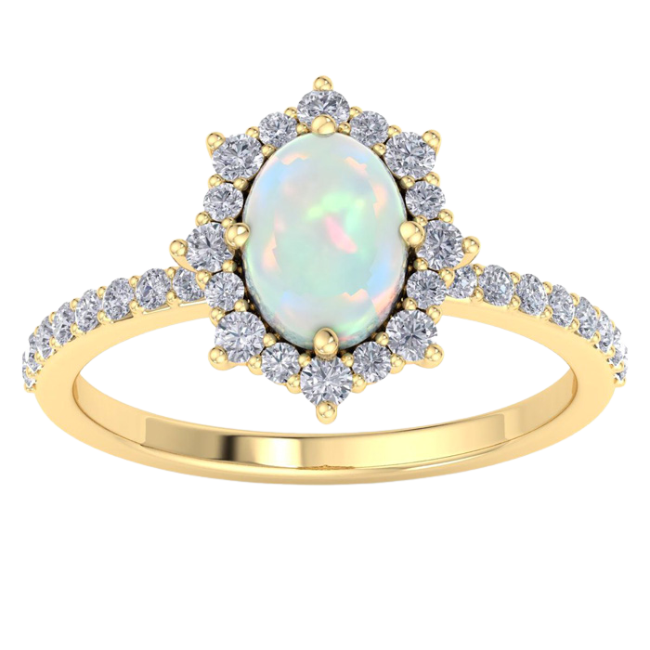
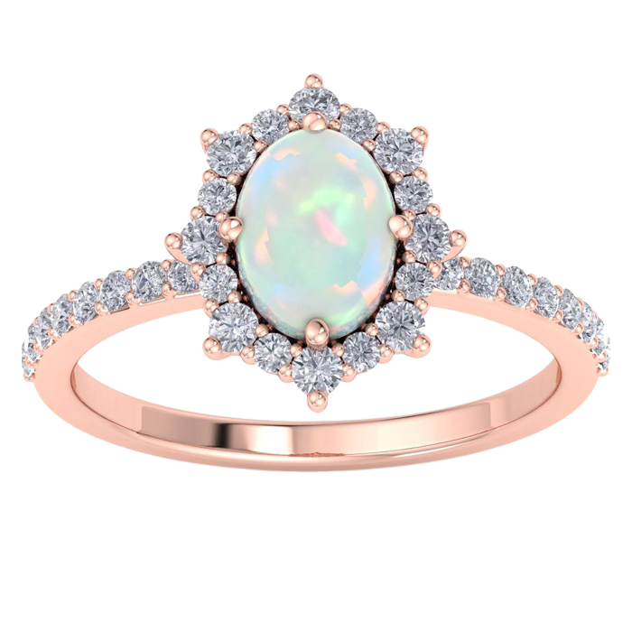
8 X 6 MM Opal & Diamond
Ring
H062207
METALS: 14K WG, YG, RG
DIAMOND QUALITY: (I-J, I1)
DIAMOND WEIGHT: 1/2 CTW
WHOLESALE
$535
Sizes 4-9.5
7

Slide 9
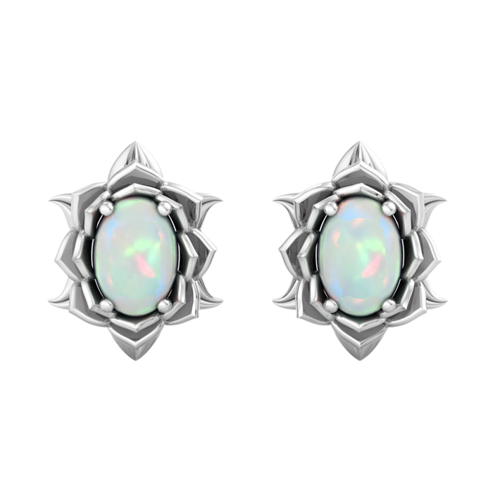
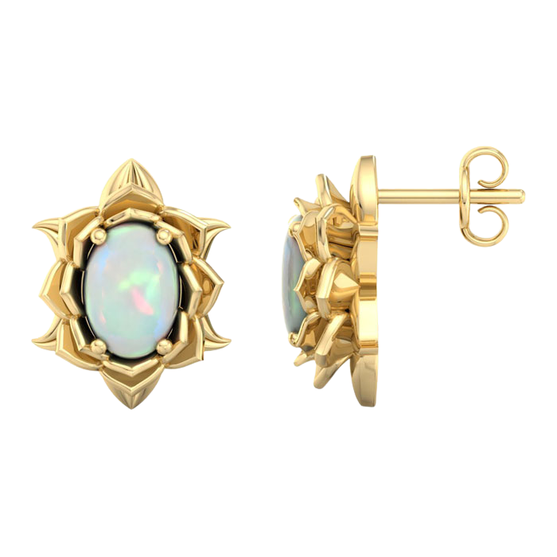
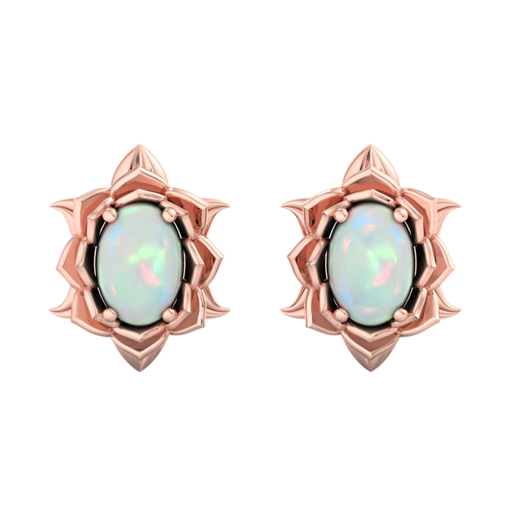
7 X 5 MM Opal
Earrings
H062211
METALS: 14K WG, YG, RG
WHOLESALE
$345
8

Slide 10
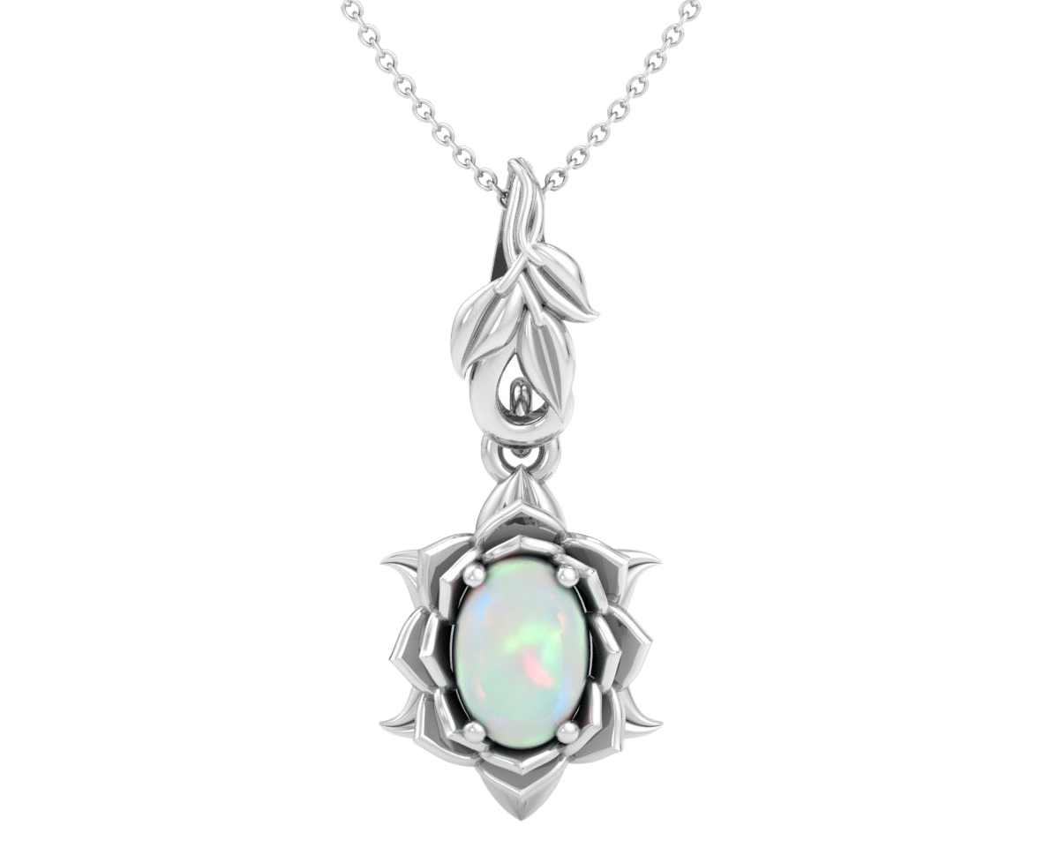
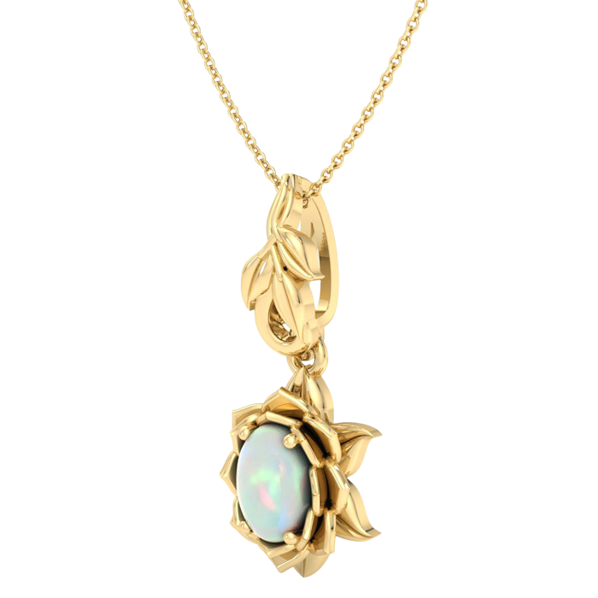
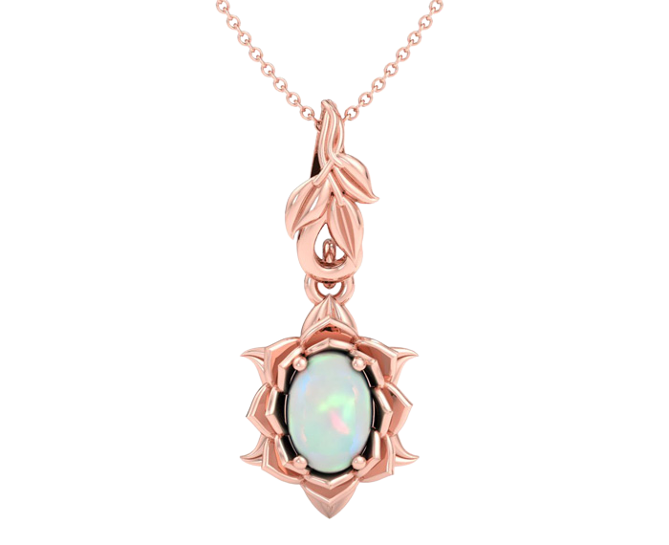
7 X 5 MM Opal
Pendant
H062212
METALS: 14K WG, YG, RG
WHOLESALE
$260
18" Chain Included
9

Slide 11
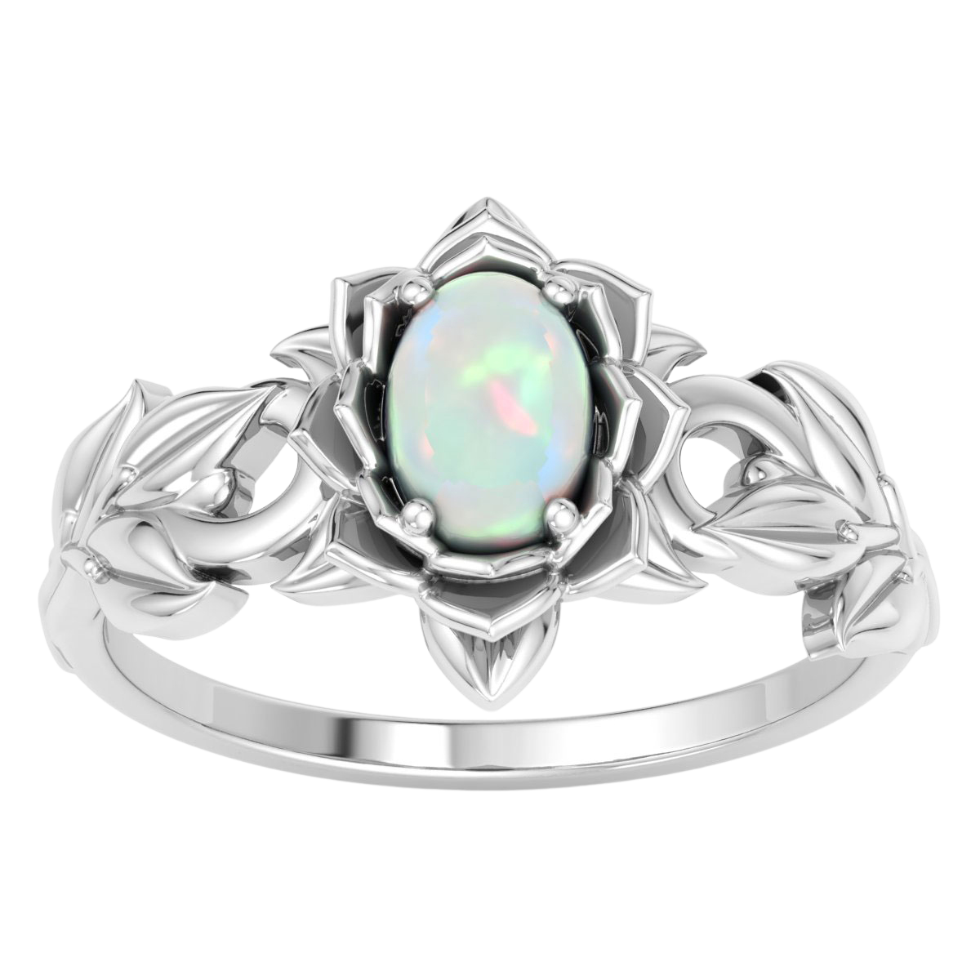
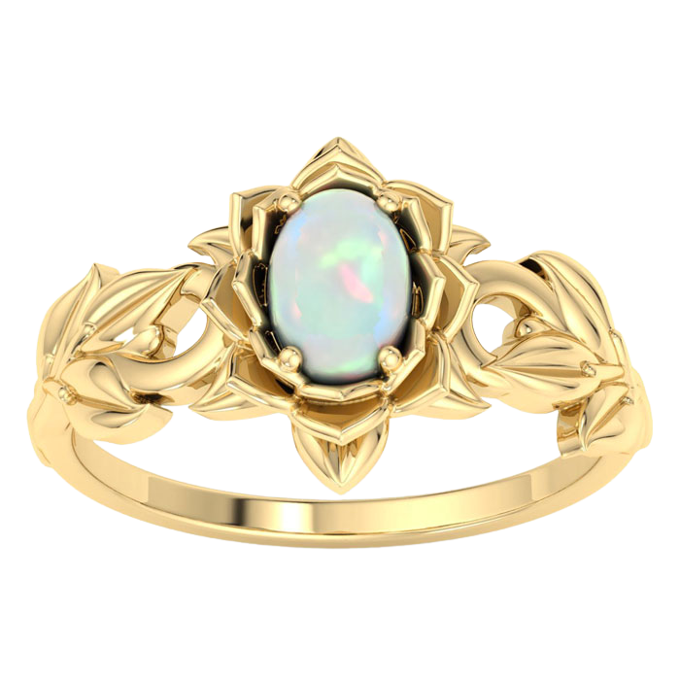
7 X 5 MM Opal
Ring
H062213
METALS: 14K WG, YG, RG
WHOLESALE
$370
Sizes 4-9.5
10

Slide 12
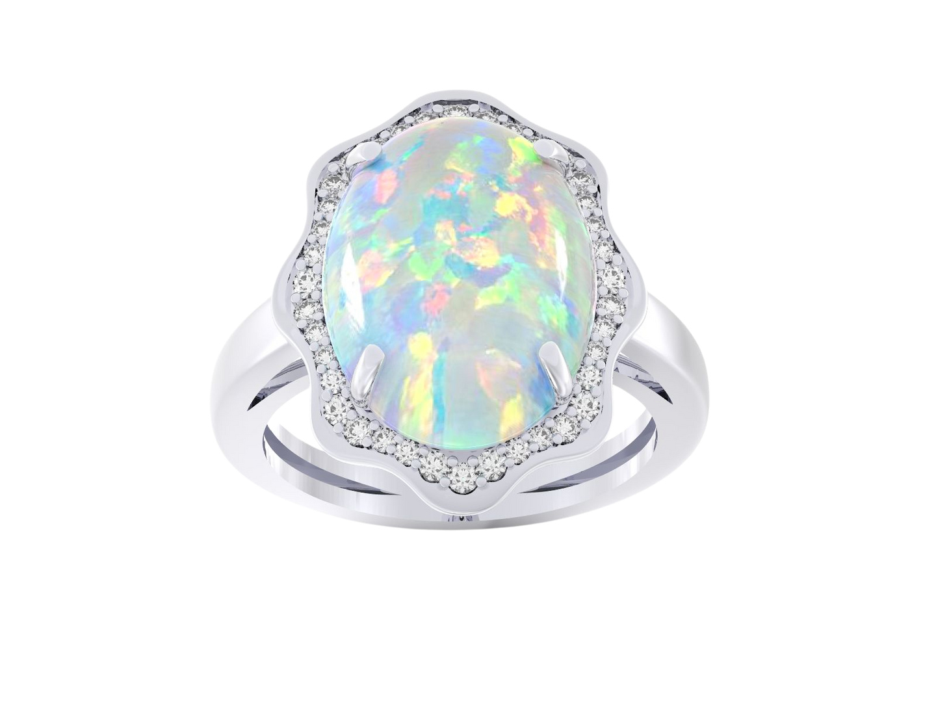
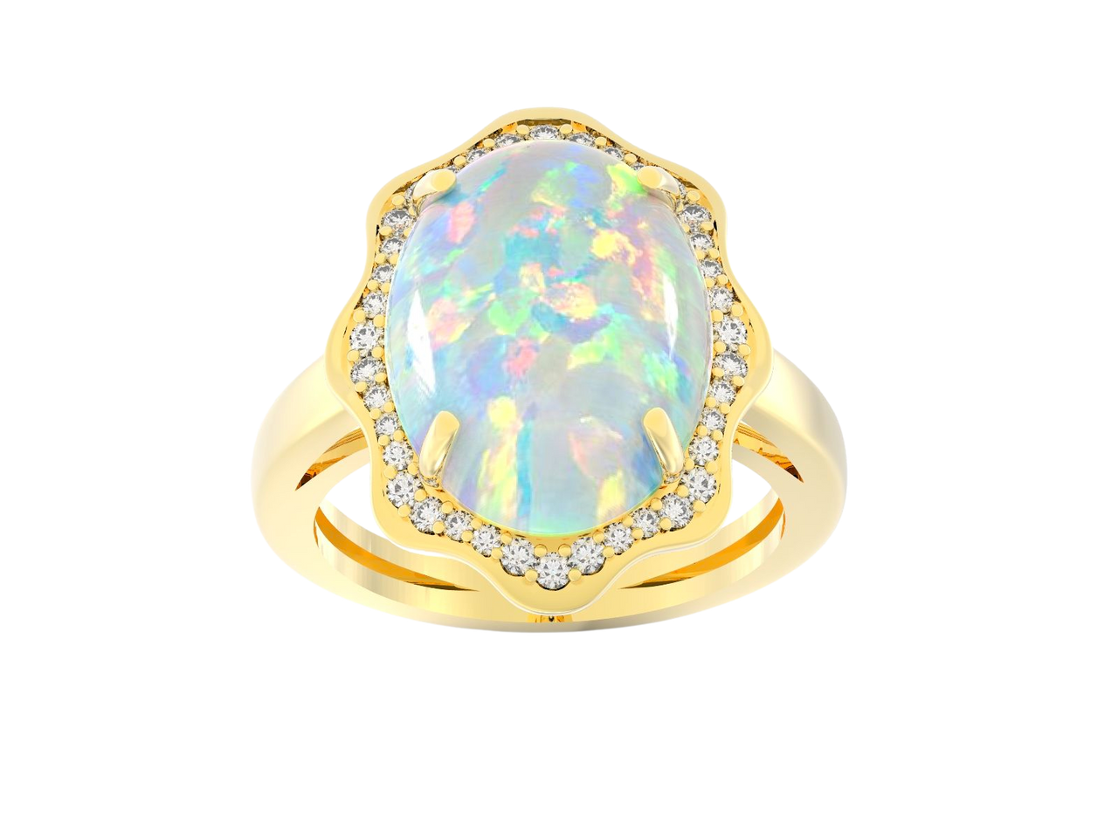
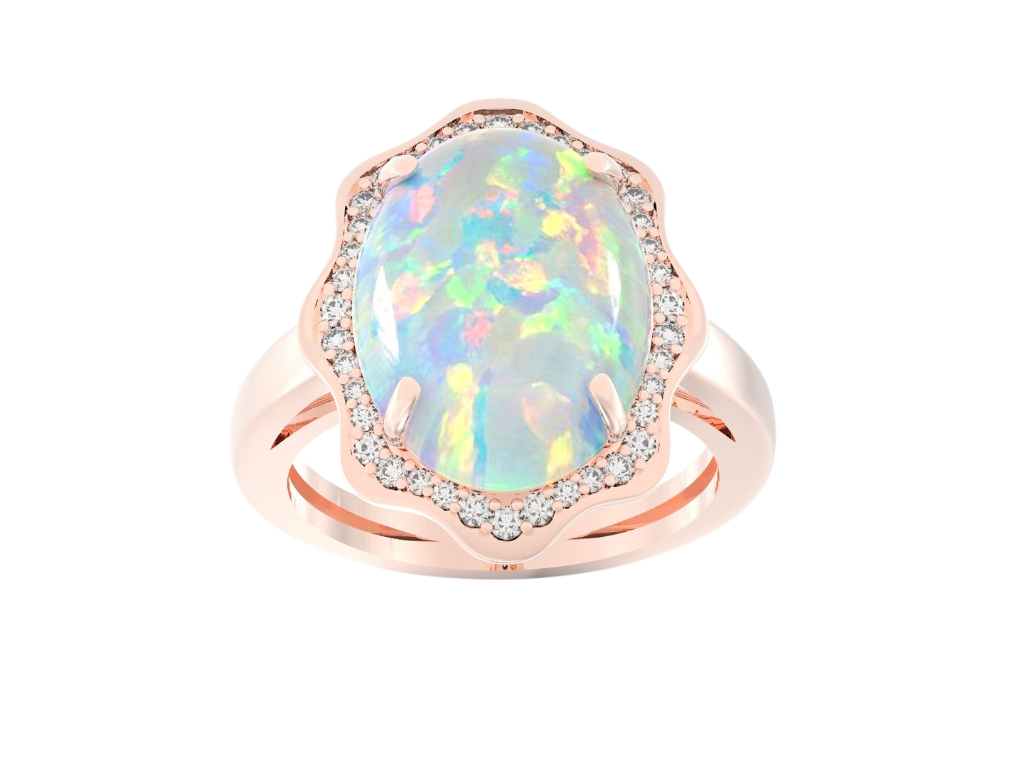
16 X 12 MM Opal & Diamond
Ring
H051724
METALS: 14K WG, YG, RG
DIAMOND QUALITY: (I-J, I1)
DIAMOND WEIGHT: 1/4 CTW
WHOLESALE
$1,375
Sizes 4-9.5
11

Slide 13
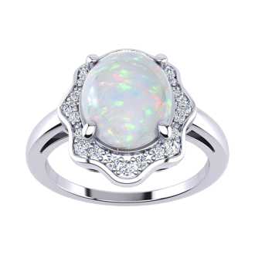
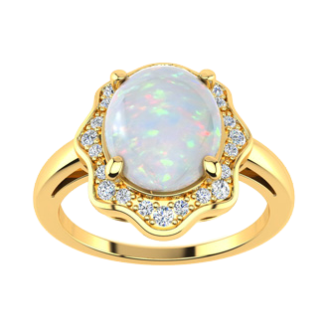
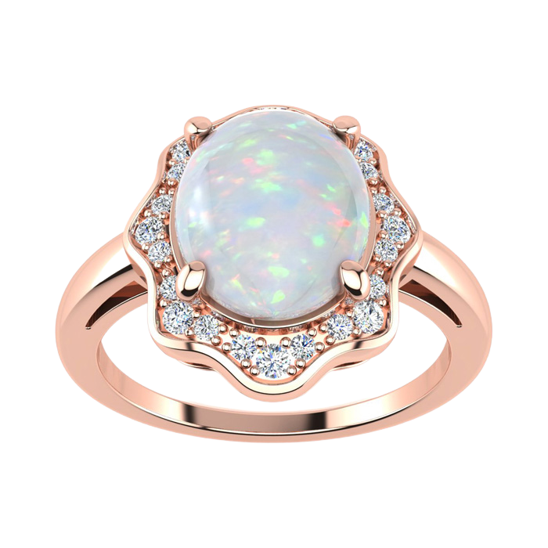
10 X 8 MM Opal & Diamond
Ring
H051725
METALS: 14K WG, YG, RG
DIAMOND QUALITY: (I-J, I1)
DIAMOND WEIGHT: 1/6 CTW
WHOLESALE
$500
Sizes 4-9.5
12

Slide 14
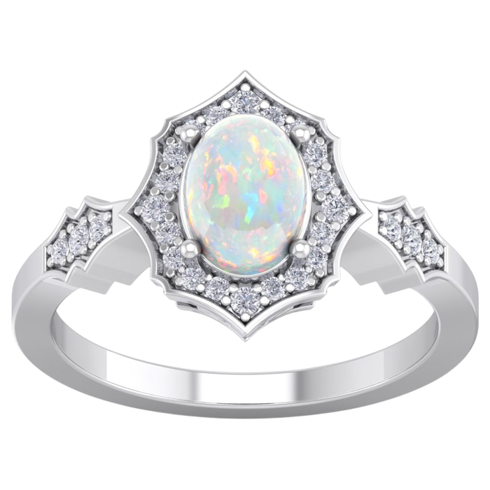
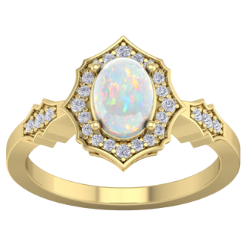
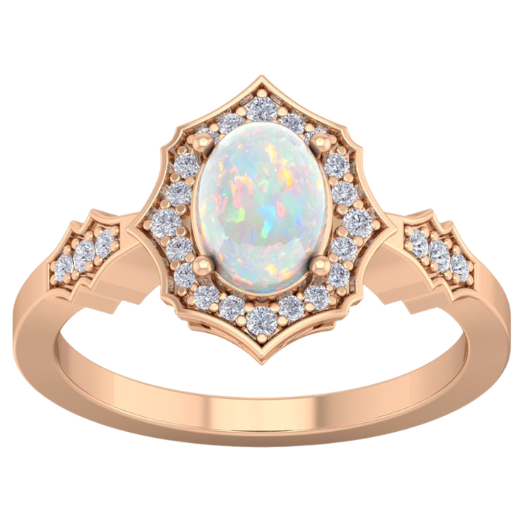
8 X 6 MM Opal & Diamond
Ring
H081930
METALS: 14K WG, YG, RG
DIAMOND QUALITY: (I-J, I1)
DIAMOND WEIGHT: 1/4 CTW
WHOLESALE
$440
Sizes 4-9.5
13

Slide 15
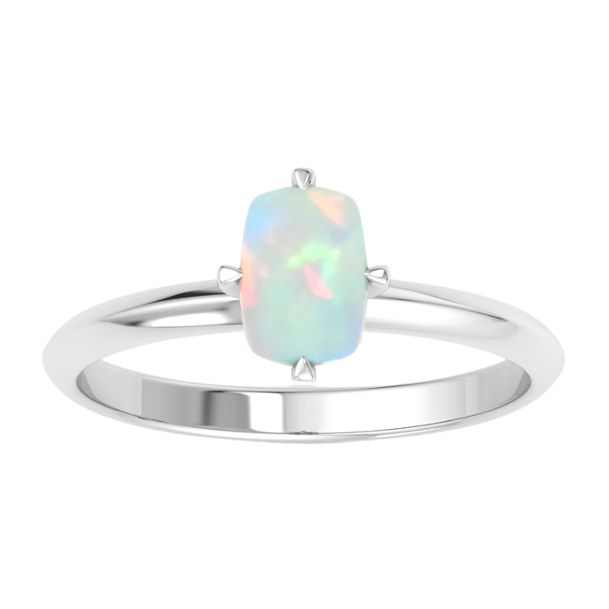
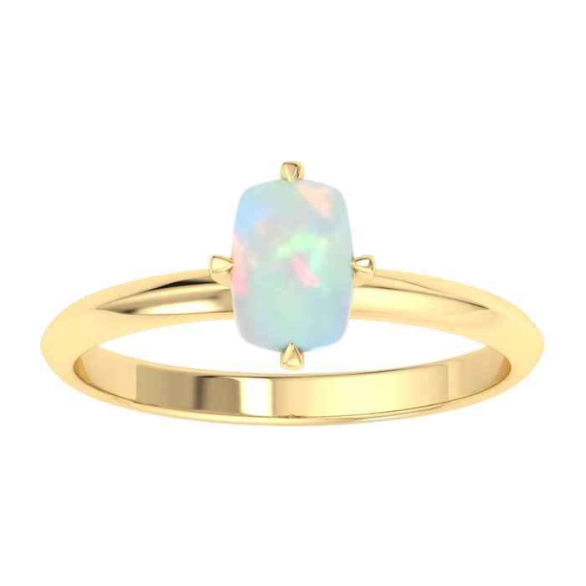
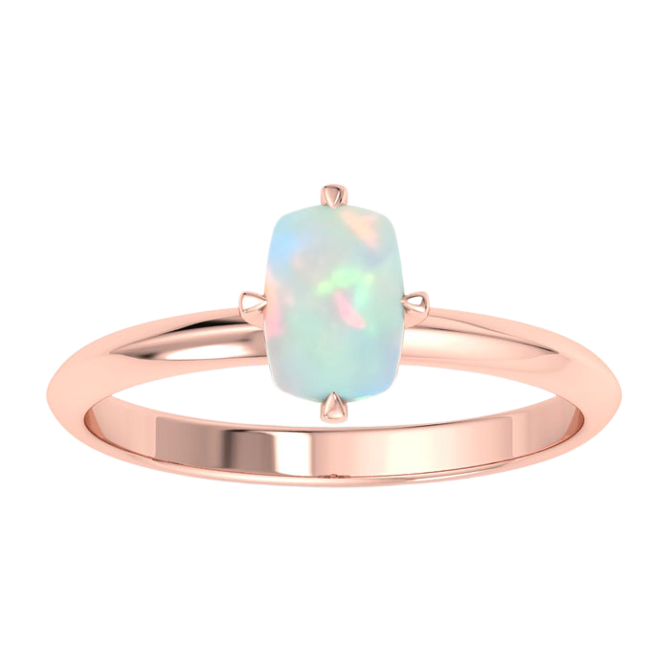
7 X 5 MM Antique Cushion Shape
Opal Ring
H062217
METALS: 14K WG, YG, RG
WHOLESALE
$200
Sizes 4-9.5
14

Slide 16
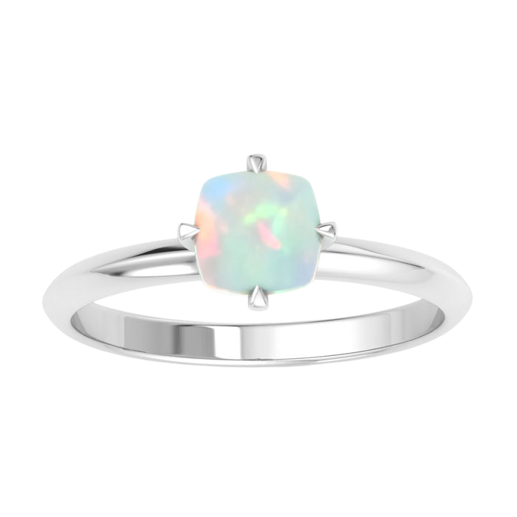
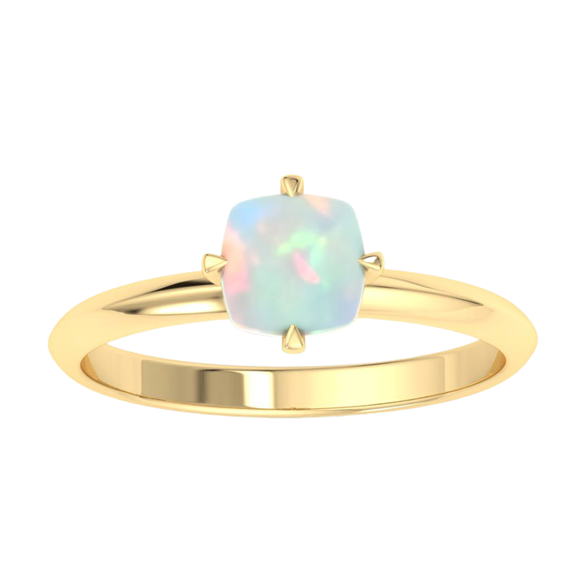
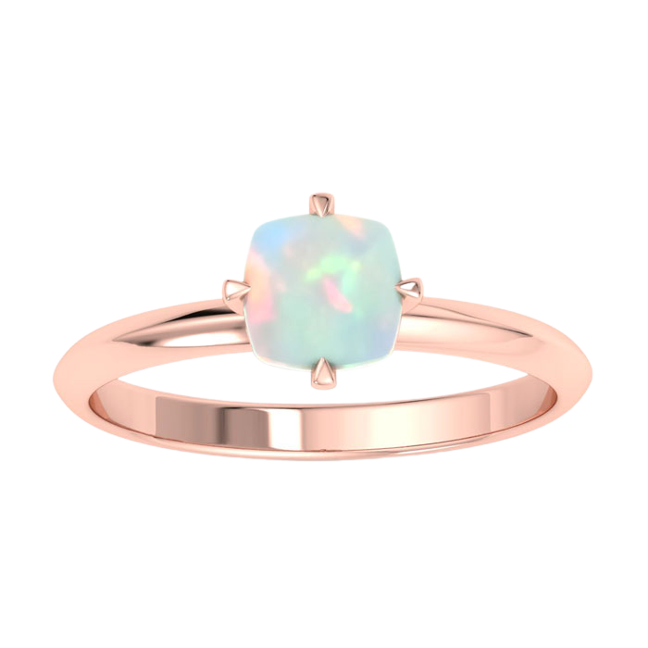
6 MM Cushion Shape
Opal Ring
H062218
METALS: 14K WG, YG, RG
WHOLESALE
$200
Sizes 4-9.5
15

Slide 17
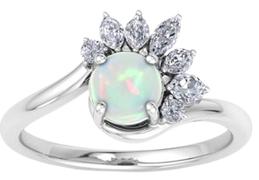
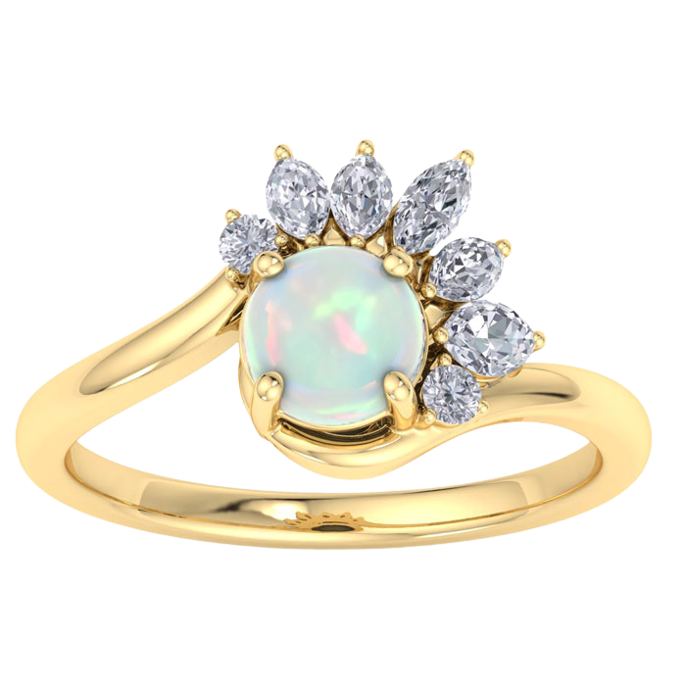
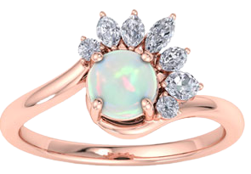
6 MM Opal & Diamond
Ring
H062219
METALS: 14K WG, YG, RG
DIAMOND QUALITY: (I-J, I1)
DIAMOND WEIGHT: 1/4 CTW
WHOLESALE
$655
Sizes 4-9.5
16

Slide 18
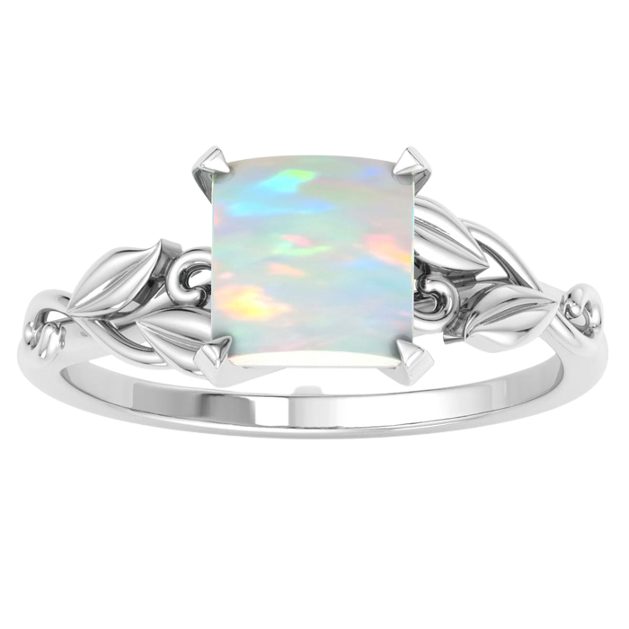
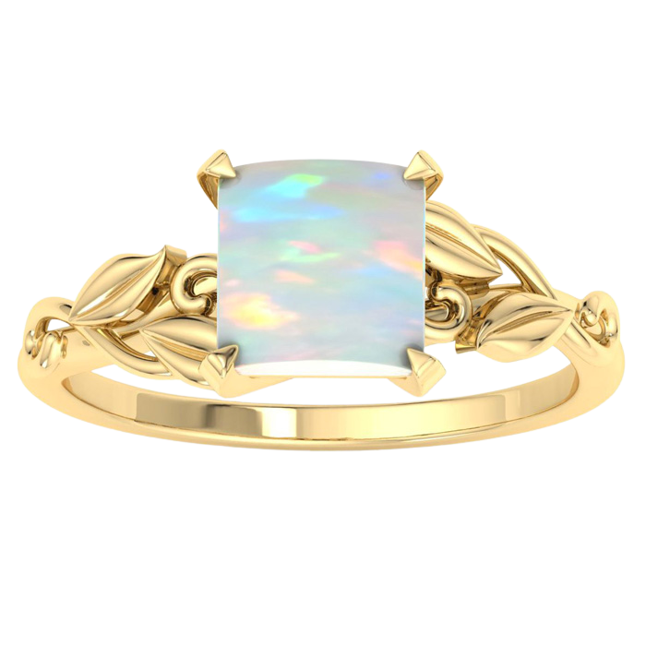
7 MM Princess Shape
Opal Ring
H062220
METALS: 14K WG, YG, RG
WHOLESALE
$275
Sizes 4-9.5
16

Slide 19
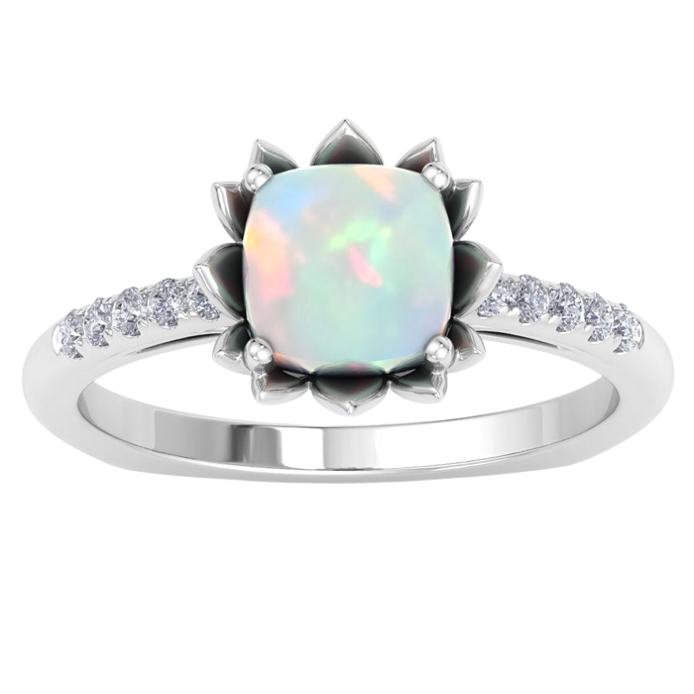
7 MM Cushion Shape
Opal & Diamond Ring
H062221
METALS: 14K WG, YG, RG
DIAMOND QUALITY: (I-J, I1)
DIAMOND WEIGHT: 1/6 CTW
WHOLESALE
$400
Sizes 4-9.5
17

Slide 20
7 X 5 MM Opal & Diamond
Ring
H062222
METALS: 14K WG, YG, RG
DIAMOND QUALITY: (I-J, I1)
DIAMOND WEIGHT: 1/4 CTW
WHOLESALE
$400
Sizes 4-9.5
18

Slide 21
About Us
• Company Founded in 1998 In New York, NY.
• Grew Quickly To Sell To Major Retailers, Regional Retailers and Small Stores.
• 2009 Transitioned to e-commerce 3pl support, including Amazon, Groupon, Overstock, Buy.com, NoMoreRack, Beyond The Rack, Zulily, etc.
• Ship up to 3,000 packages per day.
• More than 30,000 skus supported
More than 5,000 stock skus
More than 500,000 pieces in stock
Large New York In-House Factory
China production of over 2,000,000 pieces per year
• Retailers Gain the Advantage to Sell Thousands of Items From a Broad Catalog and from Immediate-Ship Daily Deals.
• Hansa Diamonds is a Jewelry Technology company. We feature a robust, fully automated back end infrastructure that enables our clients to white label sell in the black box.

Slide 22
REUBEN EBRAHIMOFF, Sales
(212) 810-1826
Reuben@HansaDiamonds.com
SCOTT BERKEBILE, VP
(646) 484-0048
Scott@HansaDiamonds.com
ANDREW FOX, President
(646) 879-6853
AF@Hansa-USA.com

