Slide 1
Natural Diamond
Statement Necklaces
Presented By

Slide 2
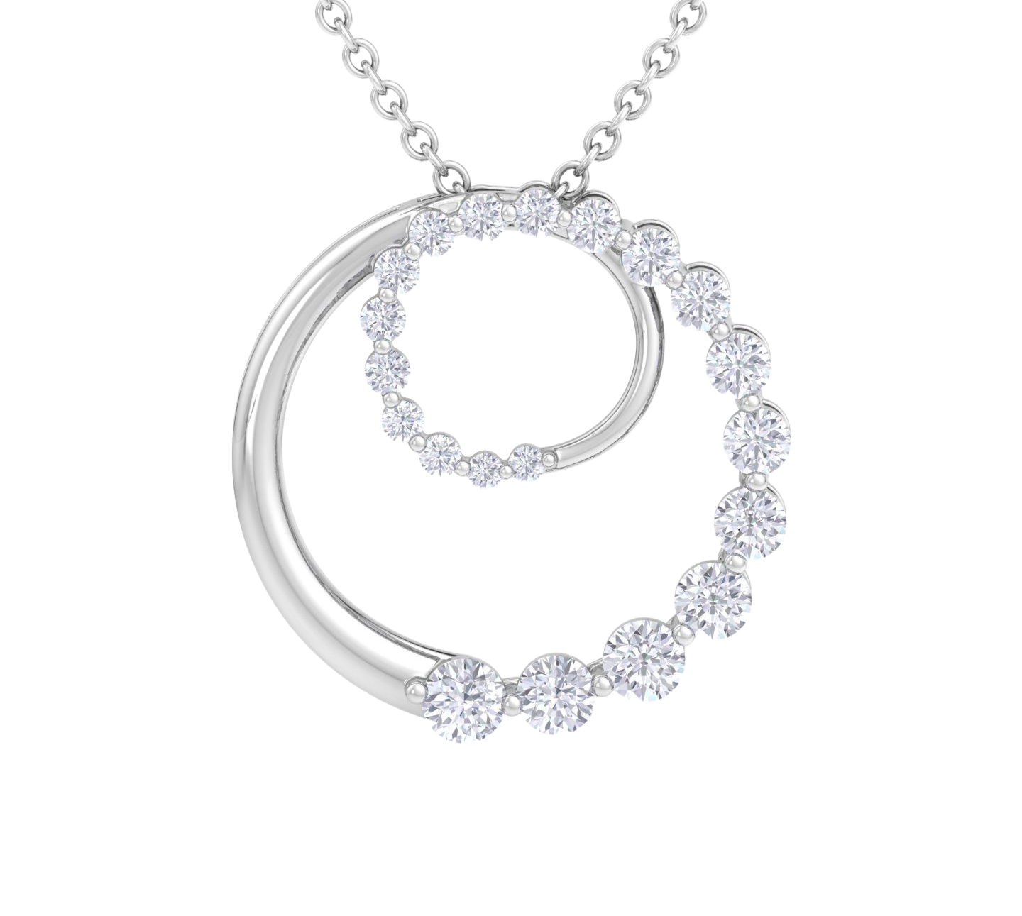
1-2 CTW Natural Diamond
Circle Necklace
STYLE # H092204 & H092205
METALS: 14K WG, YG
DIAMOND QUALITY: (I-J, I1)
PRICING
1 CTW
2 CTW
$1,399.99
$2,399.99
1

Slide 3
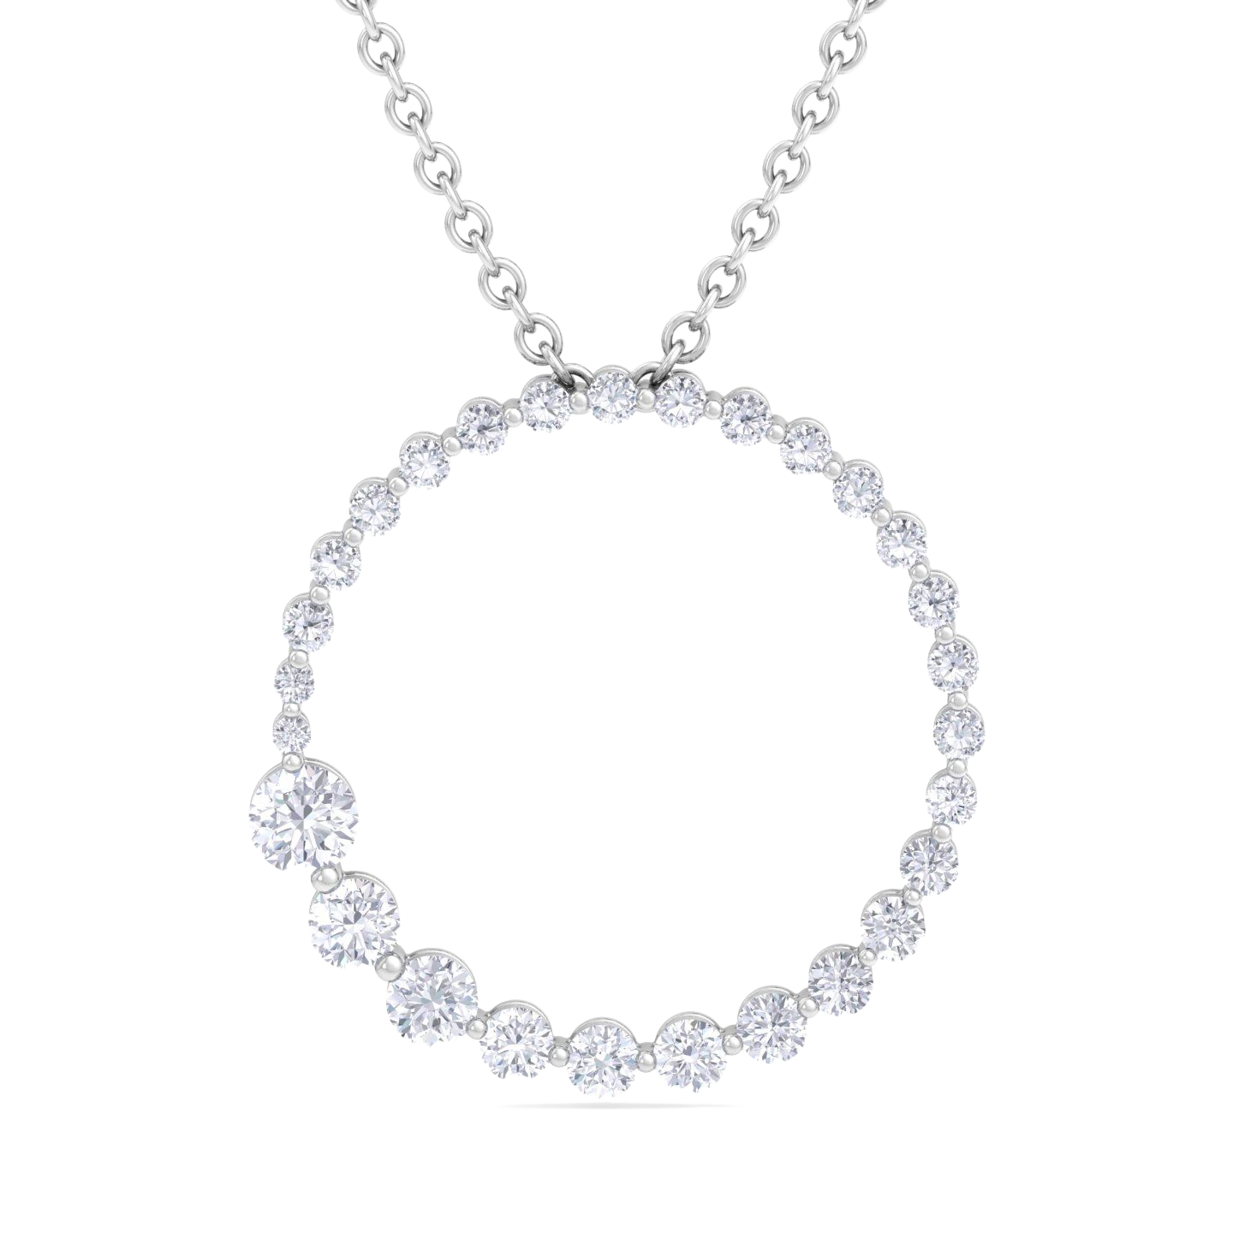
1-2 CTW Natural Diamond
Circle Necklace
STYLE # H092206 & H092207
METALS: 14K WG, YG
DIAMOND QUALITY: (I-J, I1)
PRICING
1 CTW
2 CTW
$1,299.99
$2,399.99
2

Slide 4
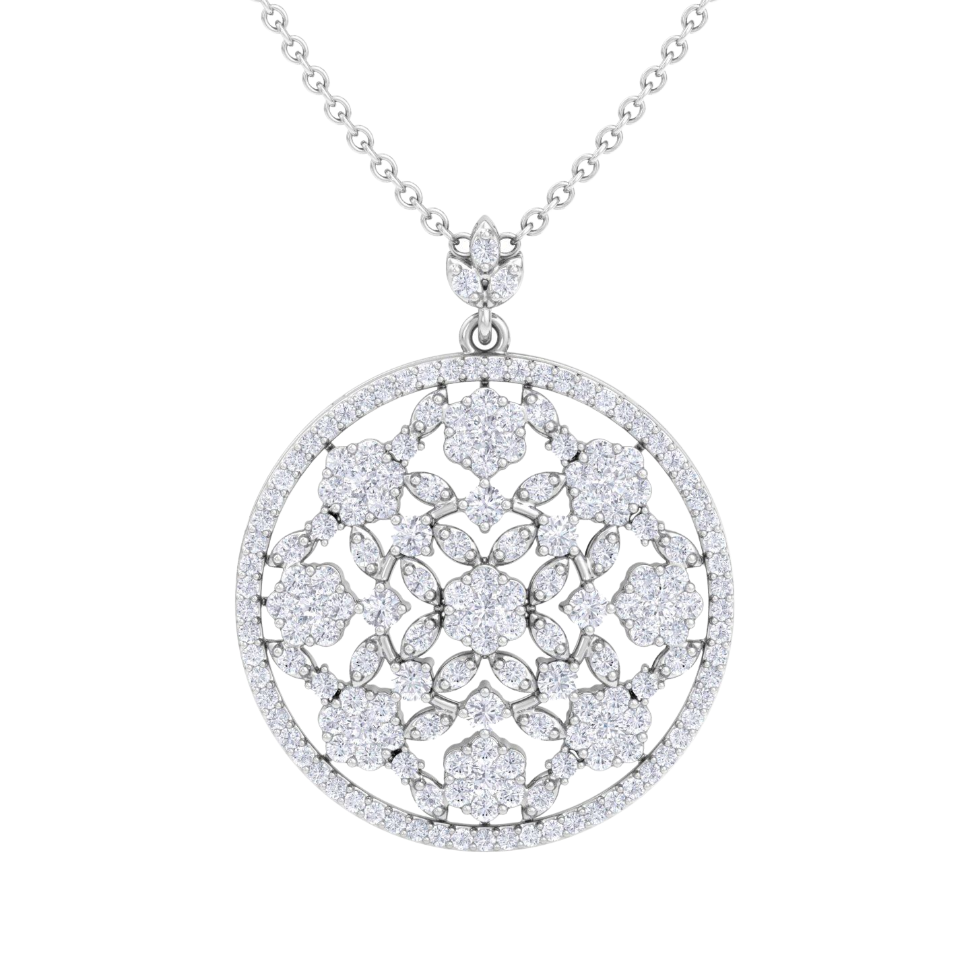
1 1/2-3 CTW Natural Diamond
Circle Necklace
STYLE # H092208 & H092209
METALS: 14K WG, YG
DIAMOND QUALITY: (I-J, I1)
PRICING
1 1/2 CTW
3 CTW
$2,199.99
$3,669.99
3

Slide 5
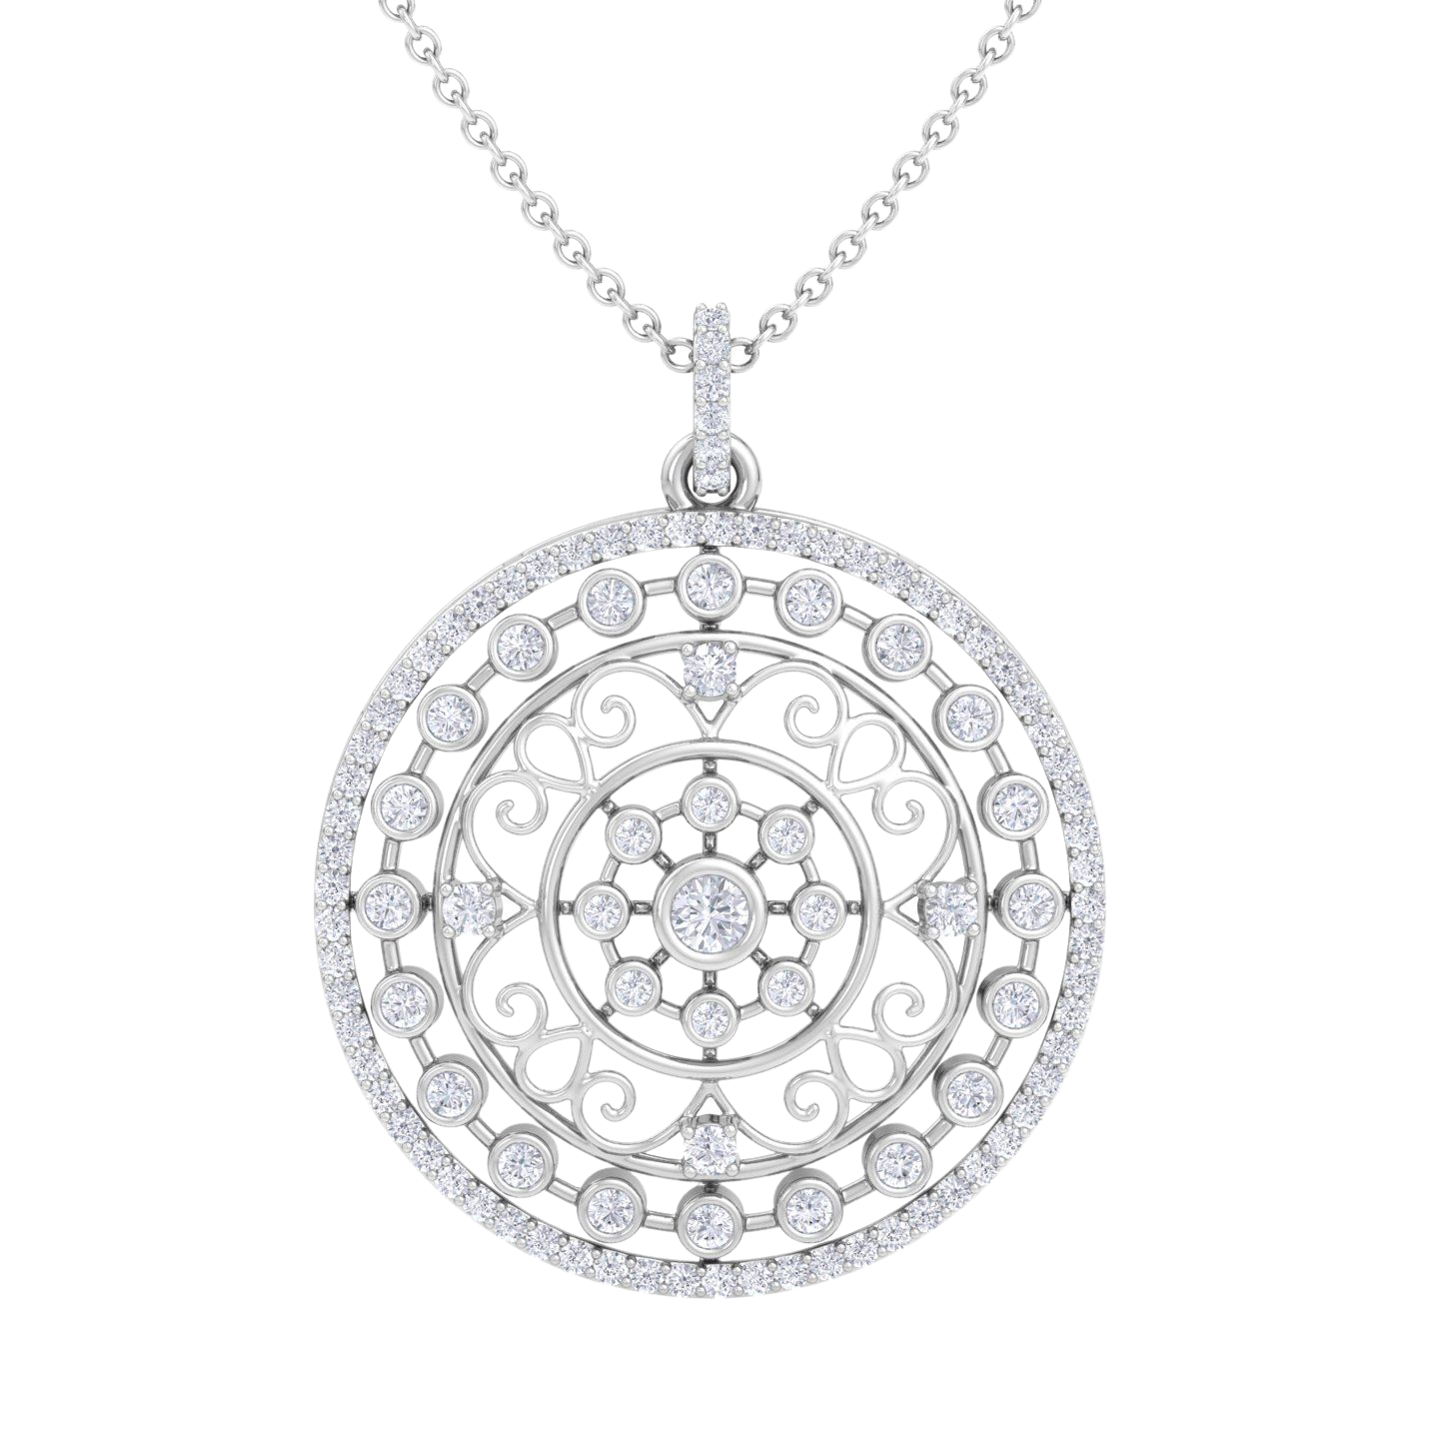
1 CTW Natural Diamond
Circle Necklace
STYLE # H092210
METALS: 14K WG, YG
DIAMOND QUALITY: (I-J, I1)
PRICING
1 CTW
$1,749.99
4

Slide 6
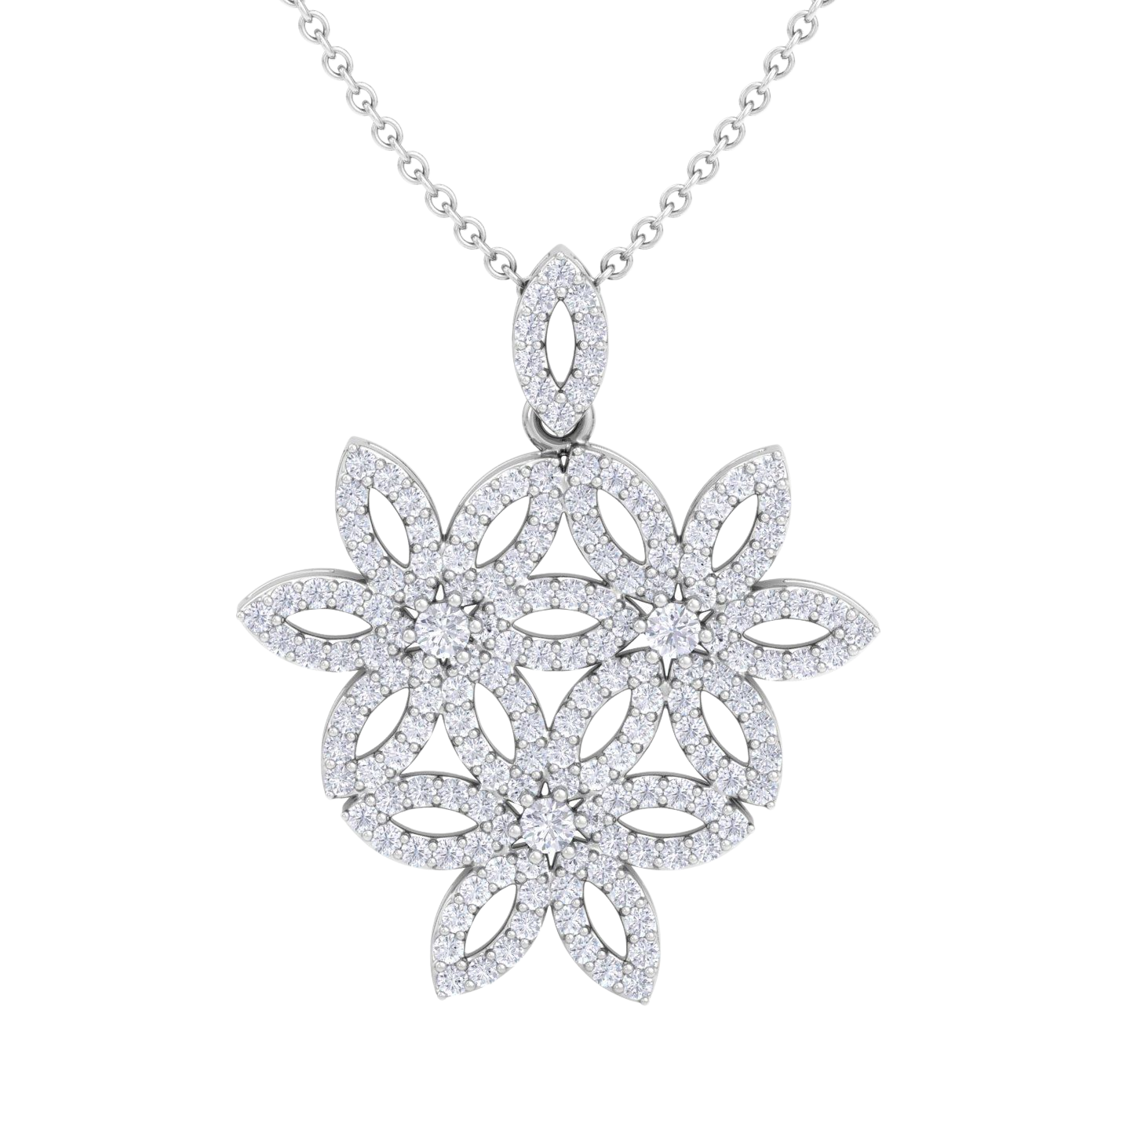
1 CTW Natural Diamond
Statement Necklace
STYLE # H092211
METALS: 14K WG, YG
DIAMOND QUALITY: (I-J, I1)
PRICING
1 CTW
$1,499.99
5

Slide 7
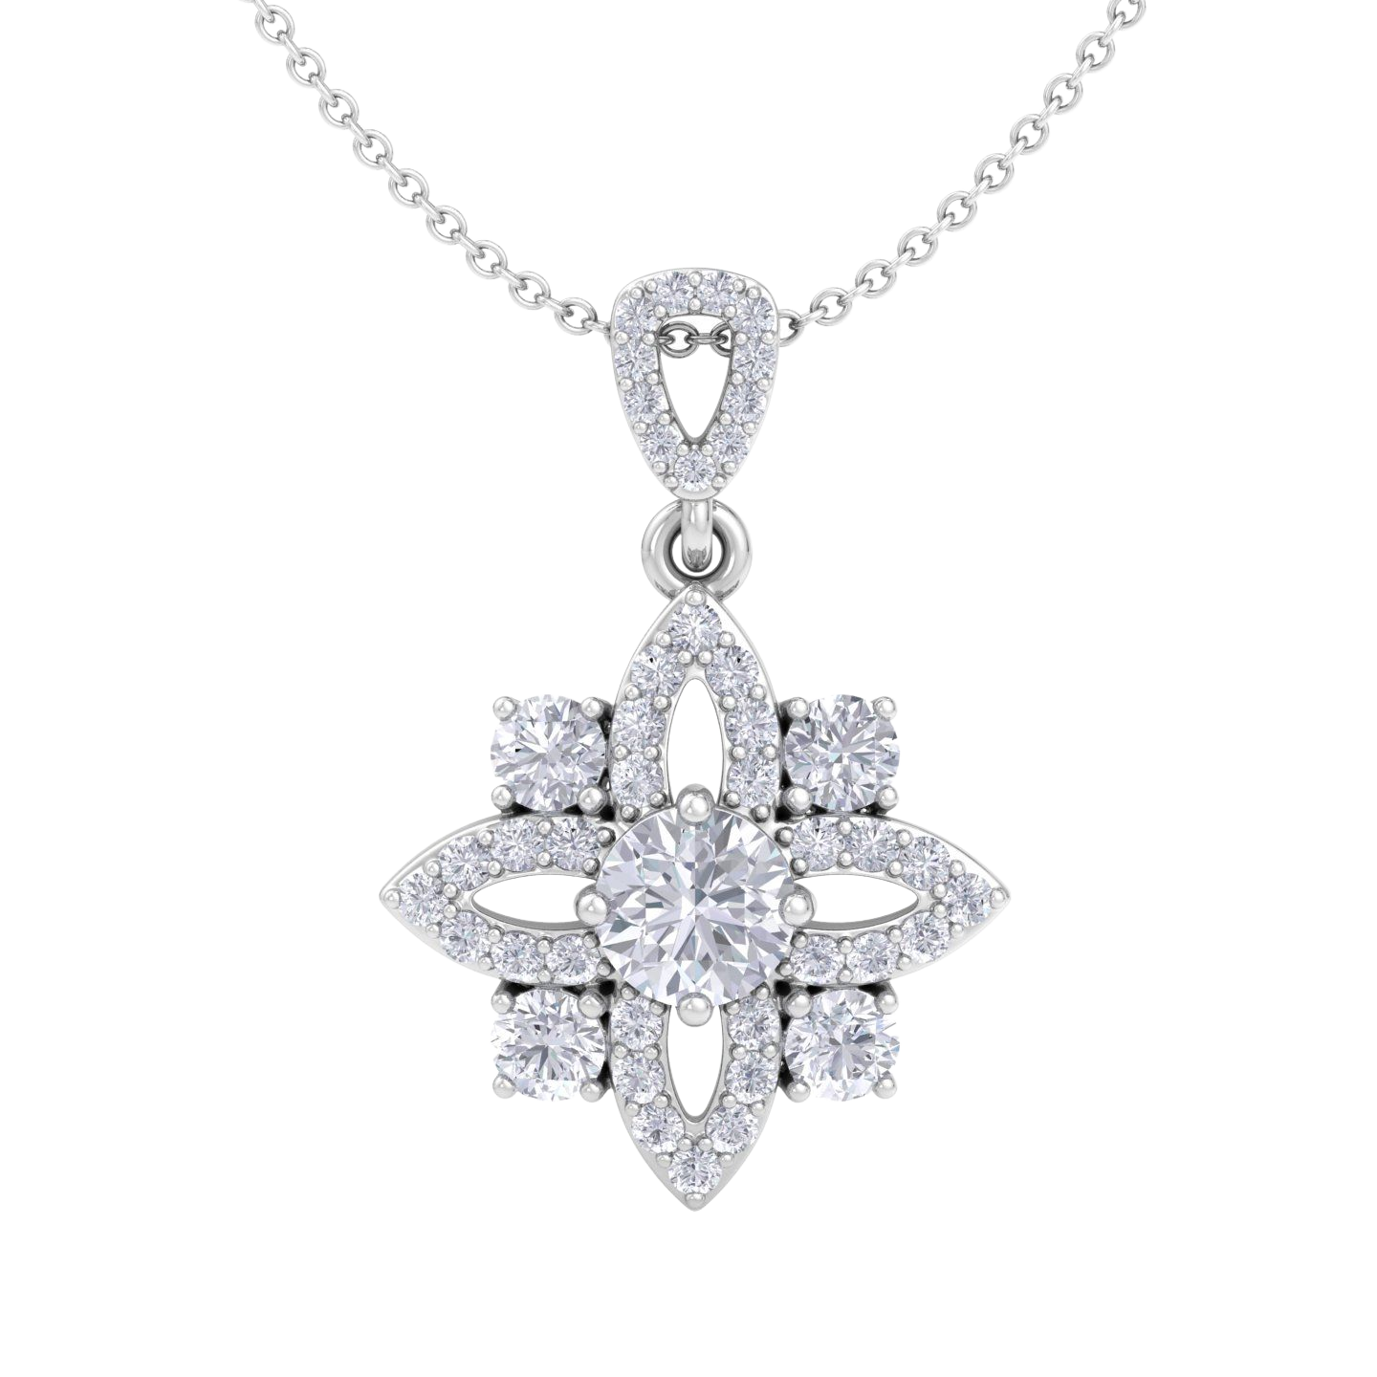
1 1/4 CTW Natural Diamond
Statement Necklace
STYLE # H092212
METALS: 14K WG, YG
DIAMOND QUALITY: (I-J, I1)
PRICING
1 1/4 CTW
$1,999.99
6

Slide 8
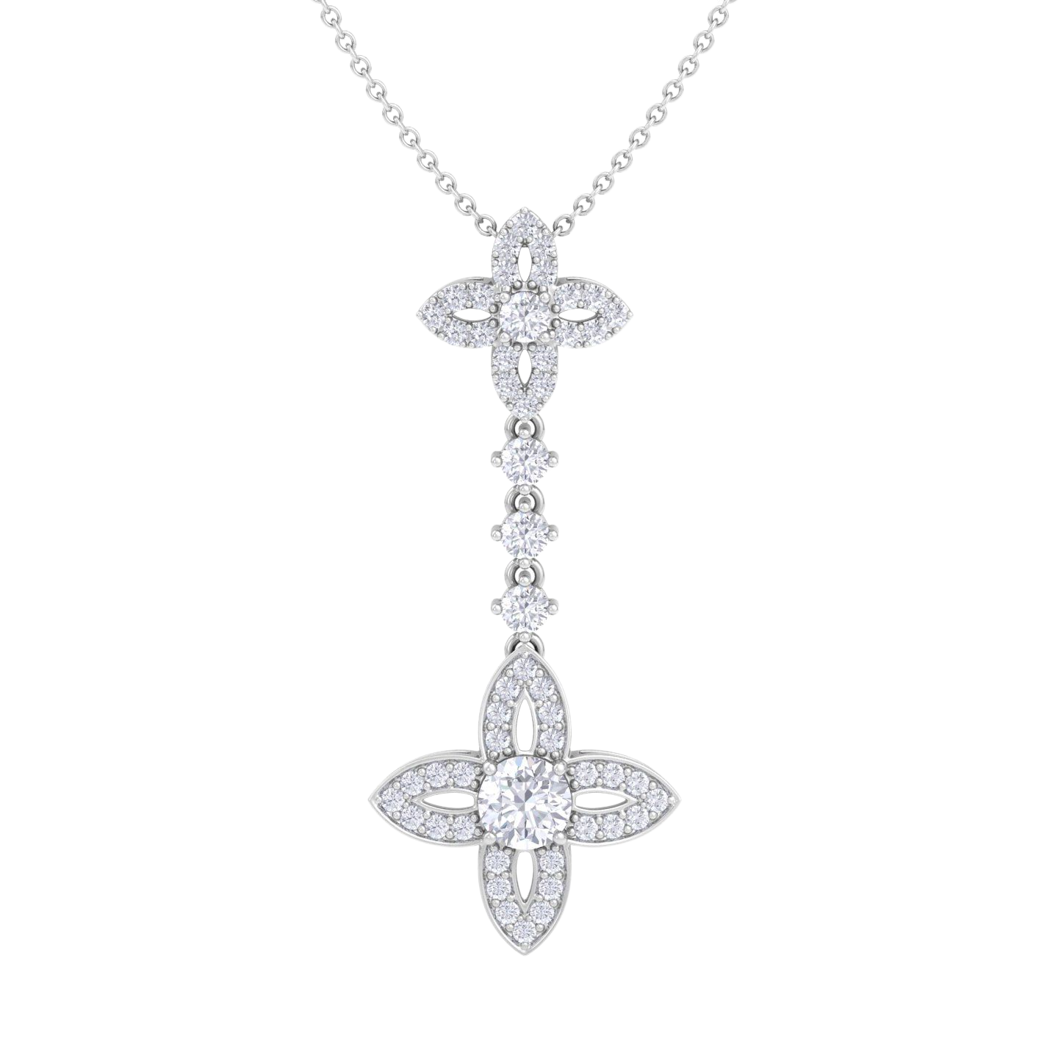
2 CTW Natural Diamond
Statement Necklace
STYLE # H092213
METALS: 14K WG, YG
DIAMOND QUALITY: (I-J, I1)
PRICING
2 CTW
$3,499.99
7

Slide 9
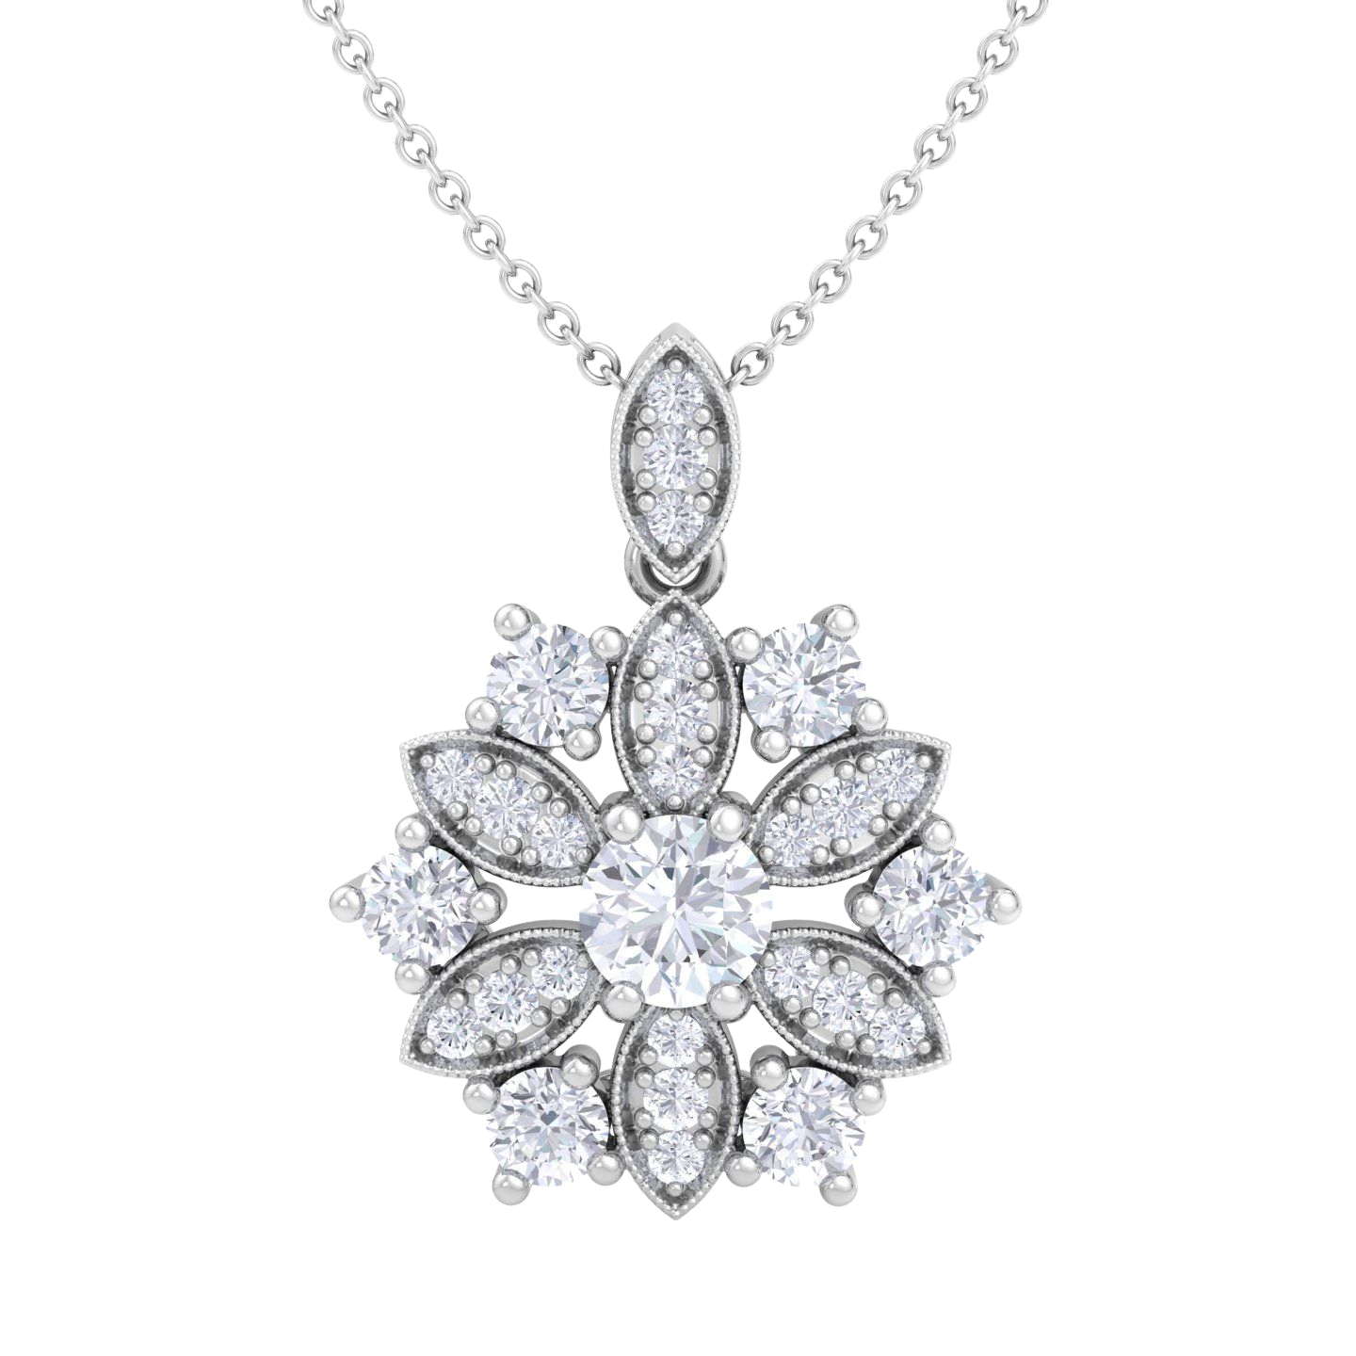
1 1/4 CTW Natural Diamond
Statement Necklace
STYLE # H092214
METALS: 14K WG, YG
DIAMOND QUALITY: (I-J, I1)
PRICING
1 1/4 CTW
$1,899.99
8

Slide 10
ITAMAR JOSEF
(347) 585-4097
IJ@SJDIA.COM

