Slide 2
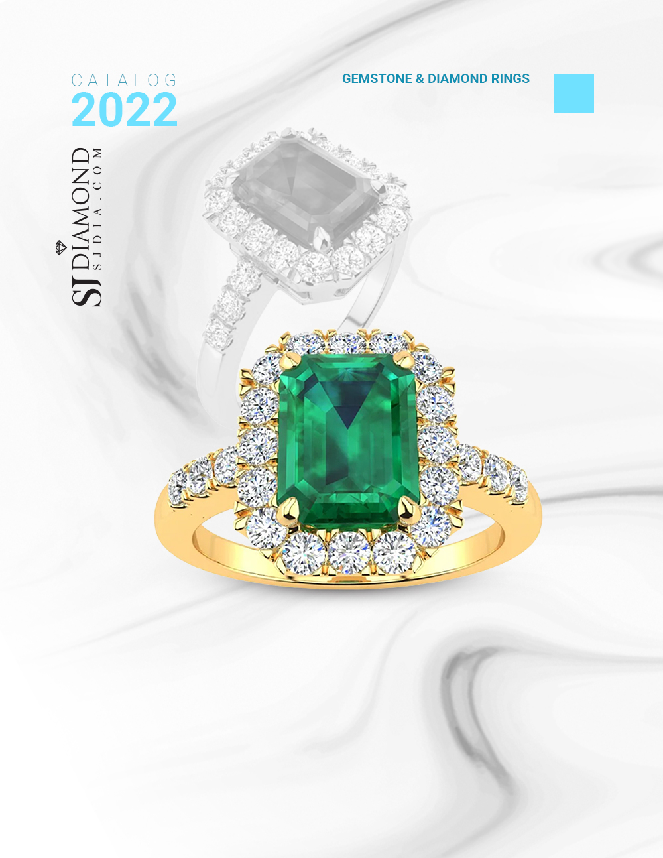
1
2 Carat Emerald and Halo Diamond Ring In 14 Karat Yellow Gold
Retail: $4,499.99
Our Price: $2,999.99
Style 21870

Slide 3
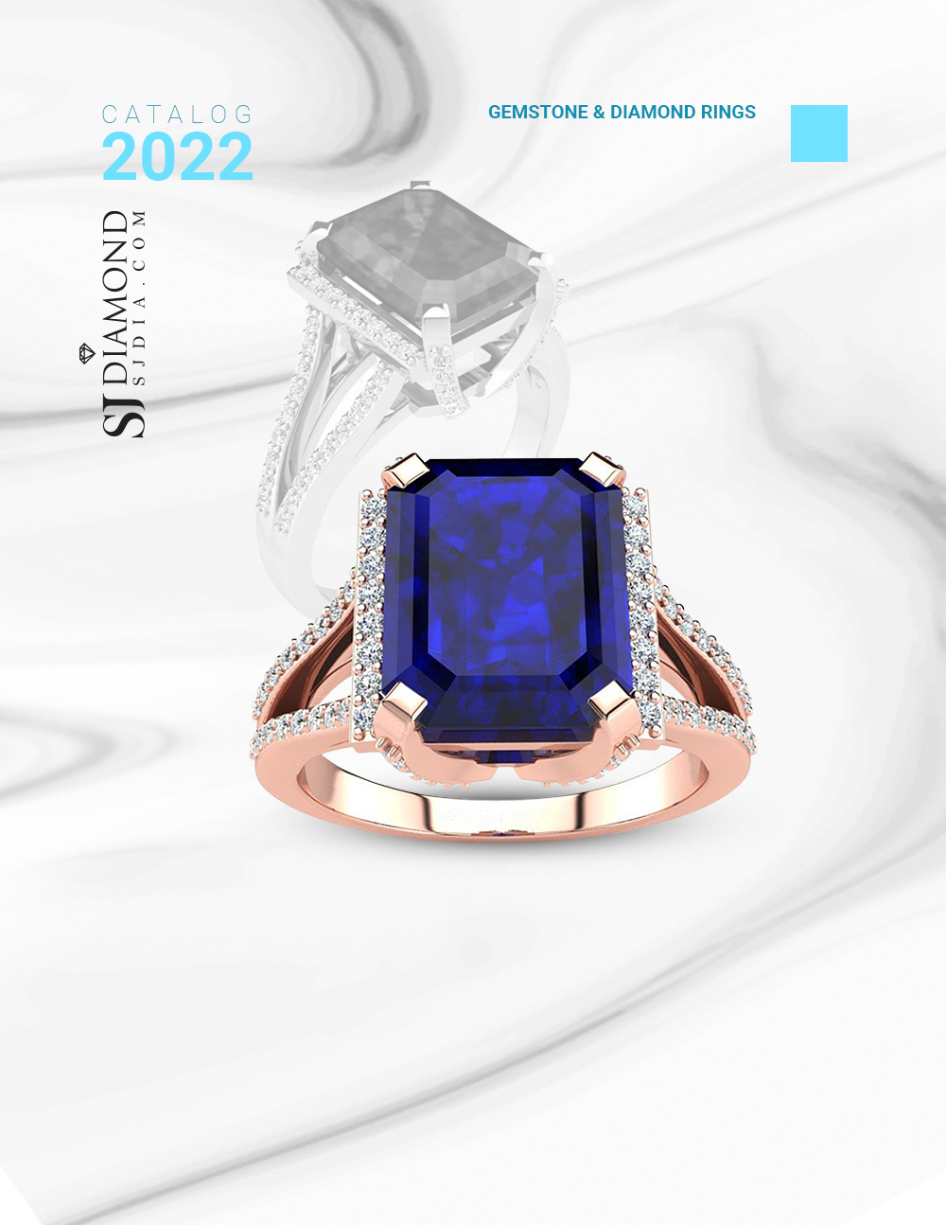
2
4 3/4 Carat Sapphire and Halo Diamond Ring In 14 Karat Rose Gold
Retail: $1,899.99
Our Price: $1,299.99
Style 21797

Slide 4
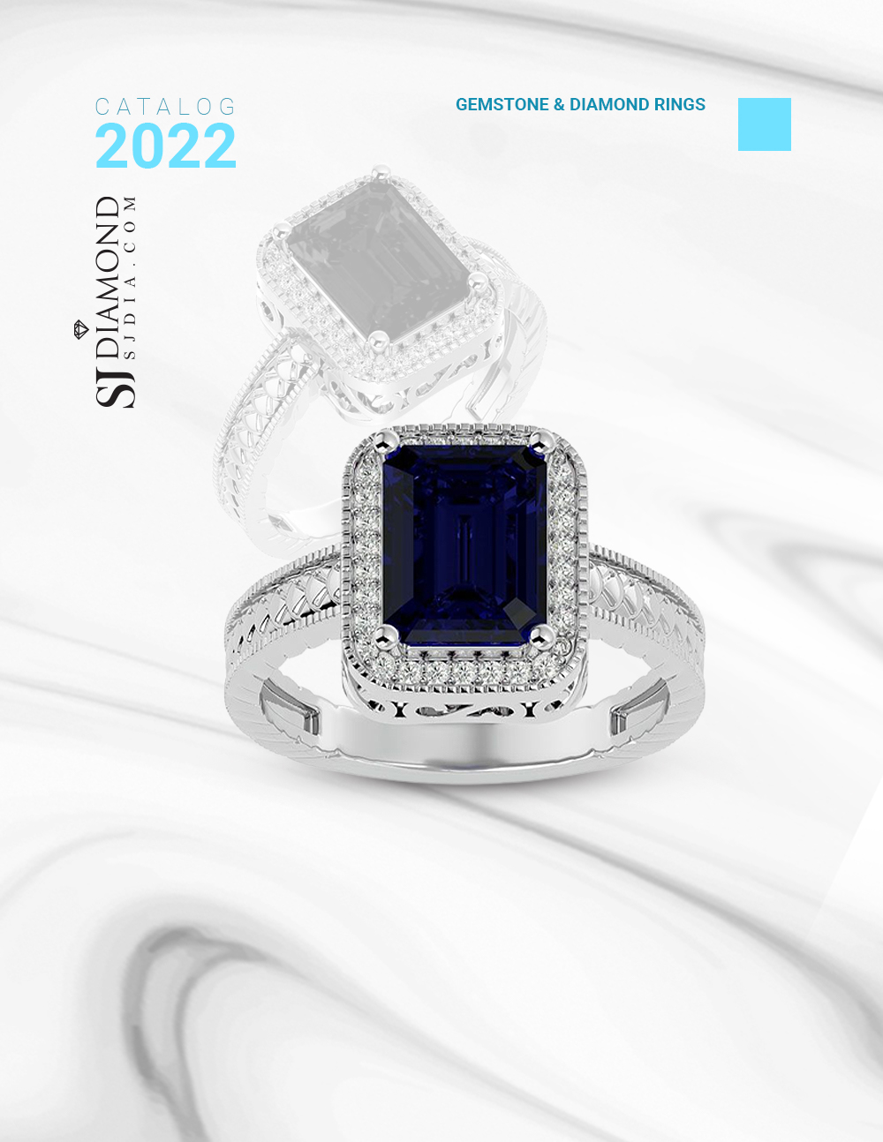
3
2 1/2 Carat Antique Style Sapphire and Diamond Ring in 14 Karat White Gold
Retail: $2,999.99
Our Price: $2,499.99
Style 6389

Slide 5
4
3 Carat Round Sapphire, Emerald or Ruby Eternity Band In 14 Karat White Gold
Retail: $3,999.99
Our Price: $2,199.99
Style 58009

Slide 6
5
3 1/2 Carat Cushion Cut Ruby and Halo Diamond Ring With Fancy Band In 14 Karat Yellow Gold
Retail: $2,999.99
Our Price: $1,999.99
Style 20728

Slide 7
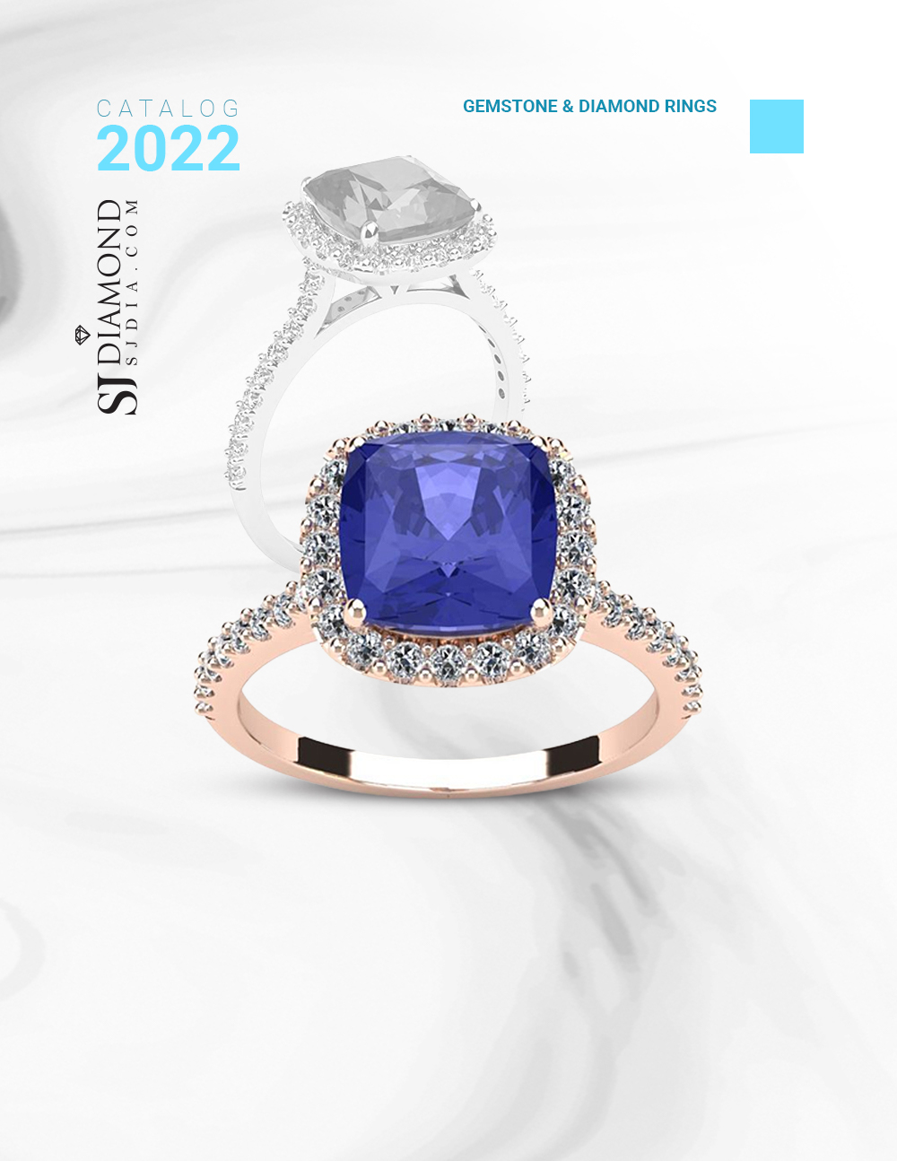
6
3 Carat Cushion Cut Tanzanite and Halo Diamond Ring In 14K Rose Gold
Retail: $2,399.99
Our Price: $1,499.99
Style 23163

Slide 8
7
3 Carat Cushion Cut Tanzanite and Halo Diamond Ring With Fancy Band In 14 Karat Rose Gold
Retail: $1,999.99
Our Price: $1,499.99
Style 20717

Slide 9
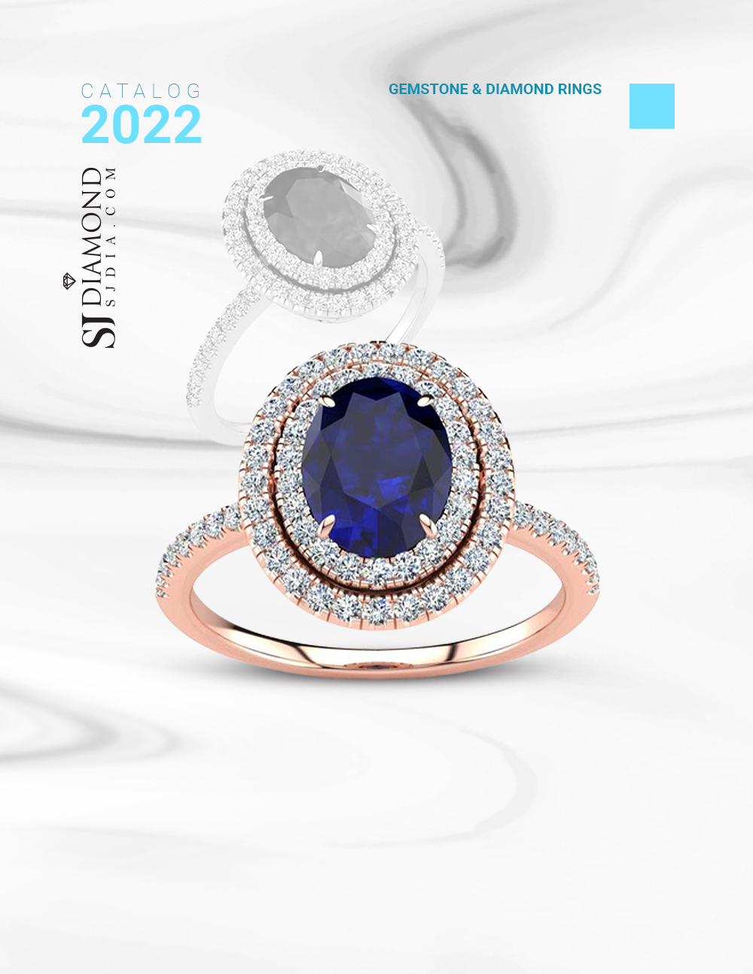
8
2 Carat Oval Shape Sapphire and Double Halo Diamond Ring In
14 Karat Rose Gold
Retail: $1,699.99
Our Price: $1,299.99
Style 20850

Slide 10
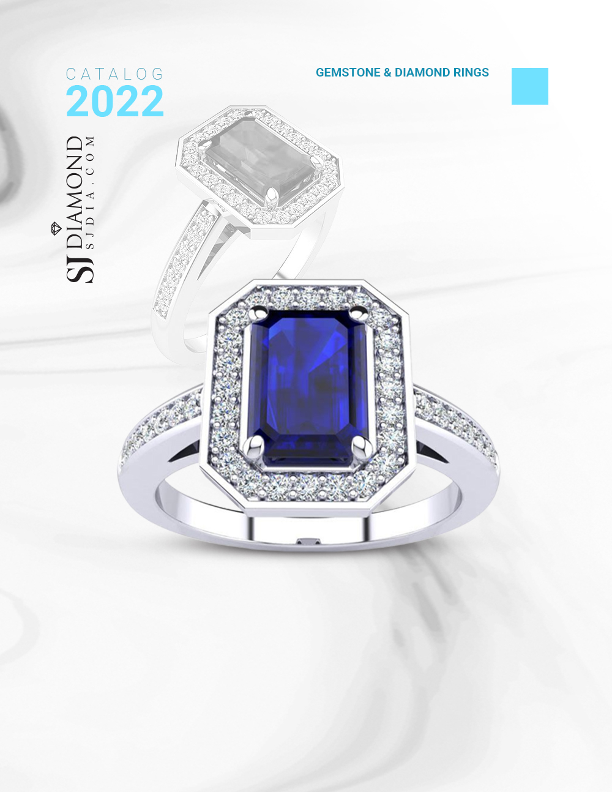
9
1 1/3 Carat Sapphire and Halo Diamond Ring In 14 Karat White Gold
Retail: $1,999.99
Our Price: $999.99
Style 24844

Slide 11
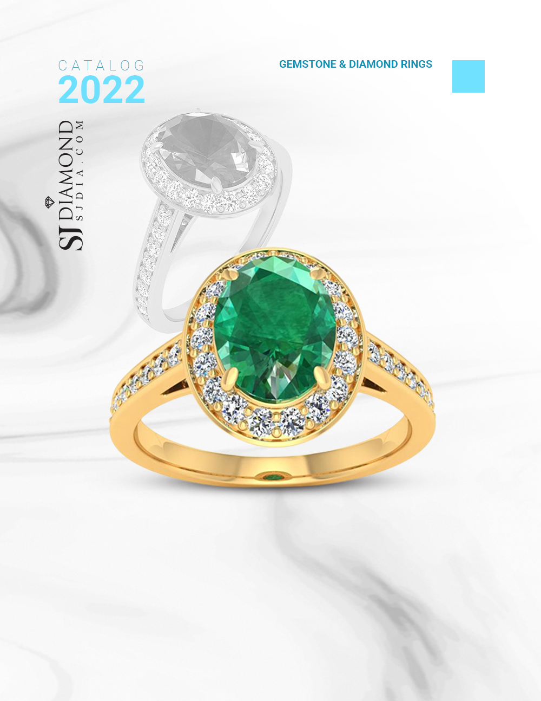
10
1 1/2 Carat Oval Shape Emerald and Halo Diamond Ring In 14 Karat Yellow Gold
Retail: $1,699.99
Our Price: $999.99
Style 21383

Slide 12
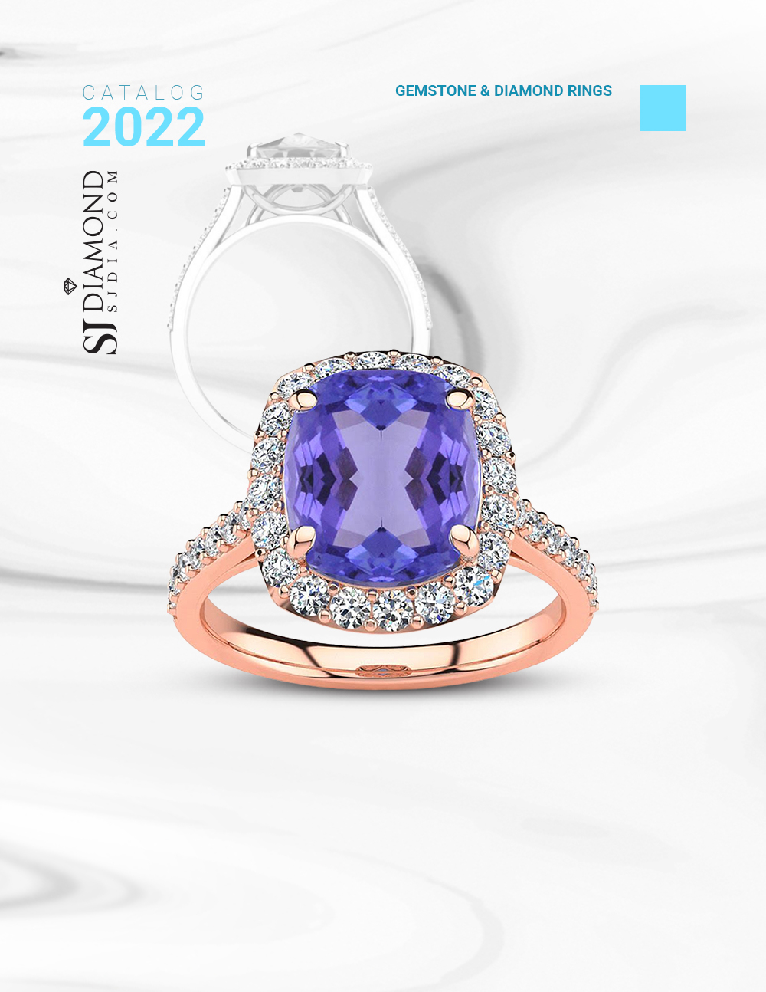
11
4 1/2 Carat Cushion Cut Tanzanite and Halo Diamond Ring In 18K Rose Gold
Retail: $7,999.99
Our Price: $3,999.99
Style 44265

Slide 13
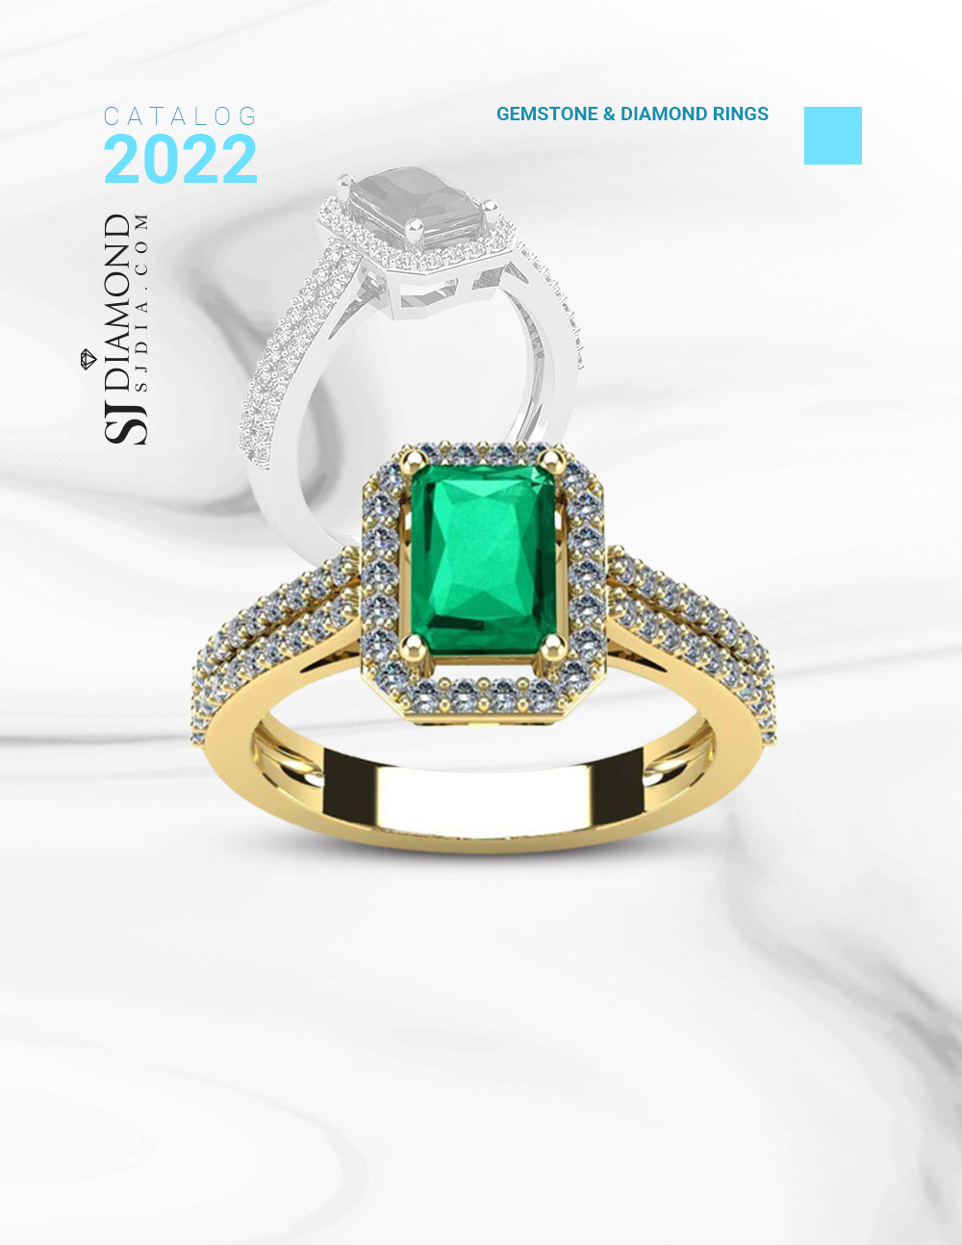
12
1 1/3 Carat Emerald and Halo Diamond Ring In 14 Karat Yellow Gold
Retail: $999.99
Our Price: $799.99
Style 21578

Slide 14
13
1 Carat Pear Shape Ruby and Double Halo Diamond Ring In
14 Karat Rose Gold
Retail: $1,099.99
Our Price: $699.99
Style 20808

Slide 15
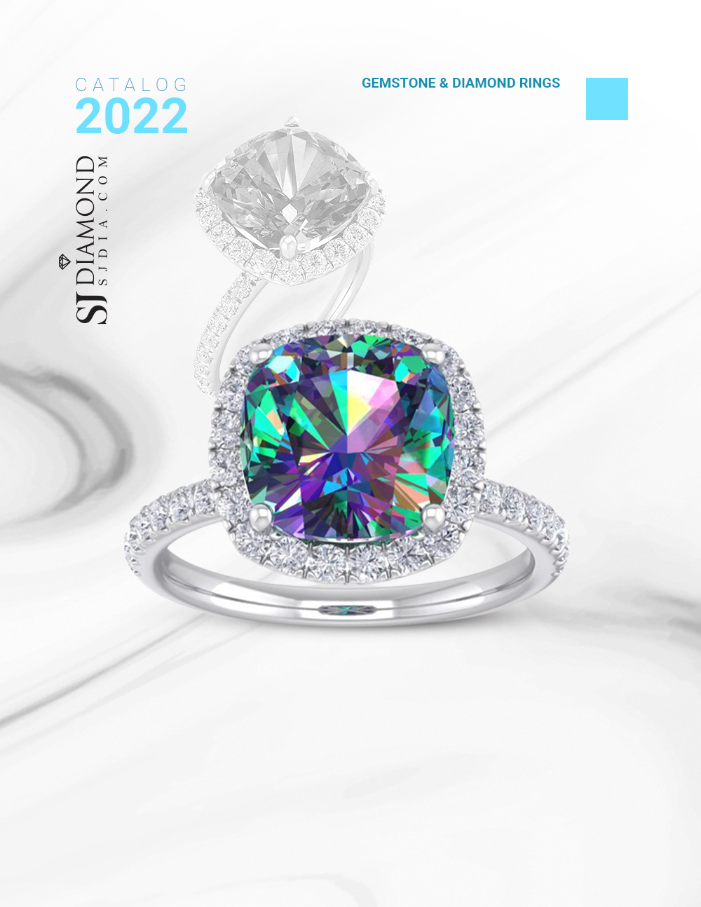
14
5 1/2 Carat Cushion Cut
Mystic Topaz and Diamond Ring
In 14 Karat White Gold
Retail: $1,199.99
Our Price: $999.99
Style 47297

Slide 16
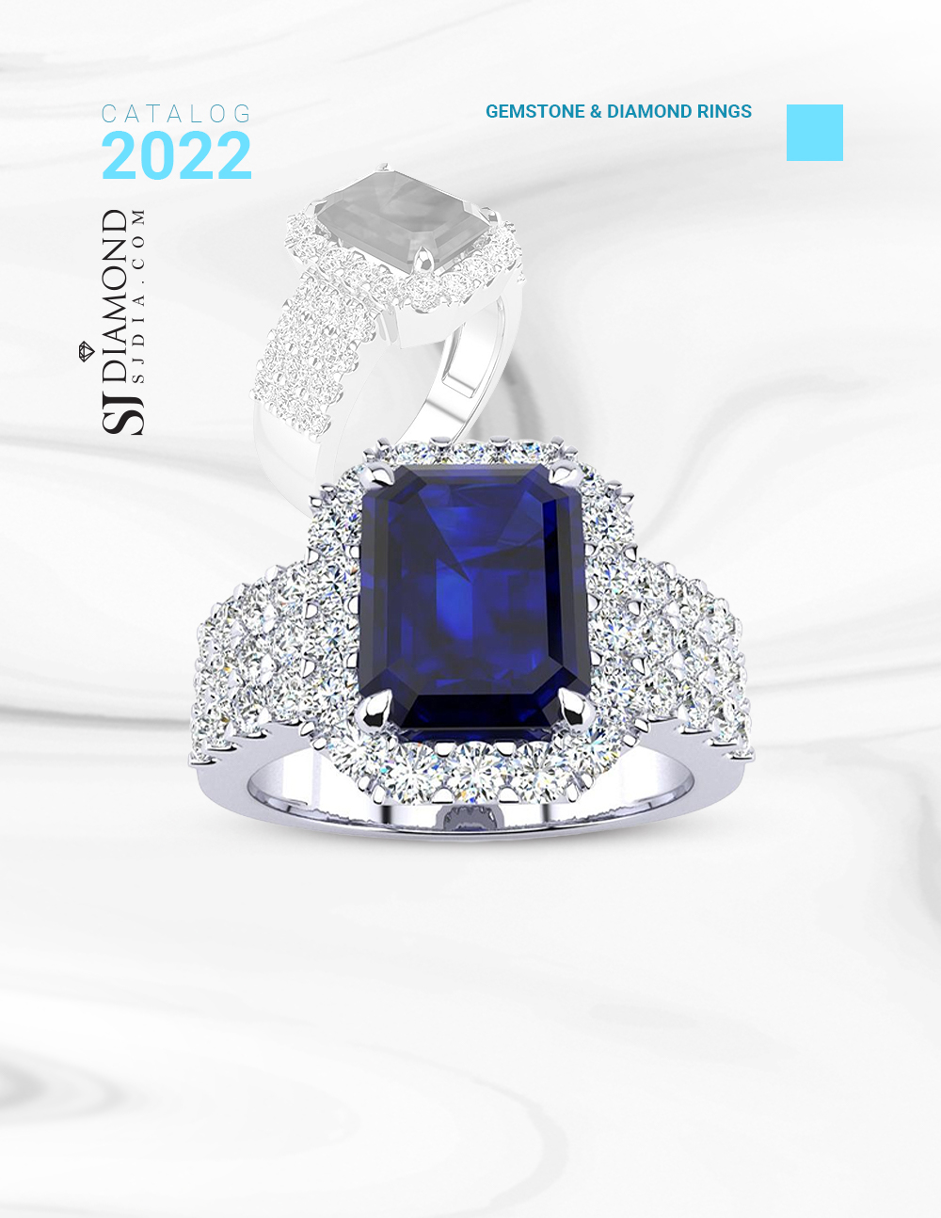
15
3 3/4 Carat Sapphire and Halo Diamond Ring In 14 Karat White Gold
Retail: $4,999.99
Our Price: $2,499.99
Style 21437

Slide 17
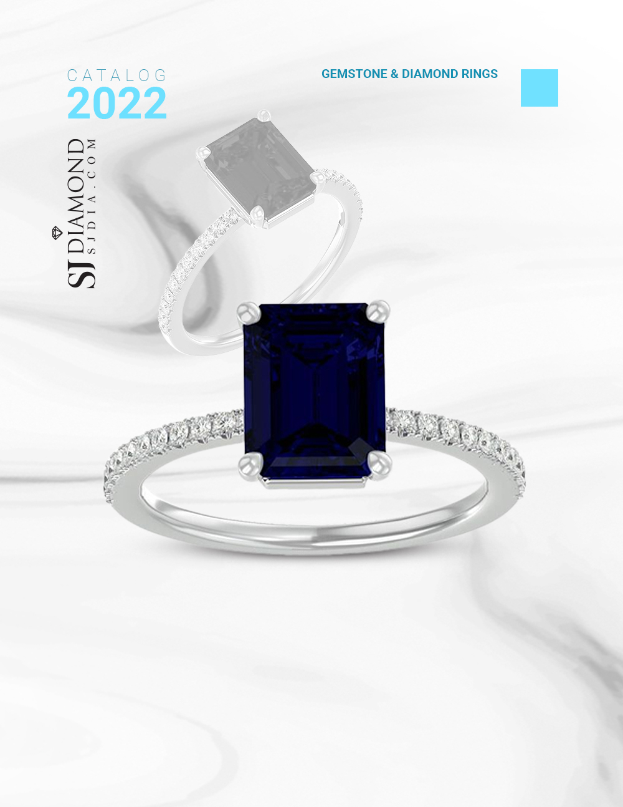
16
2 1/2 Carat Sapphire and Diamond Ring In 14 Karat White Gold
Retail: $1,299.99
Our Price: $899.99
Style 25835

Slide 18
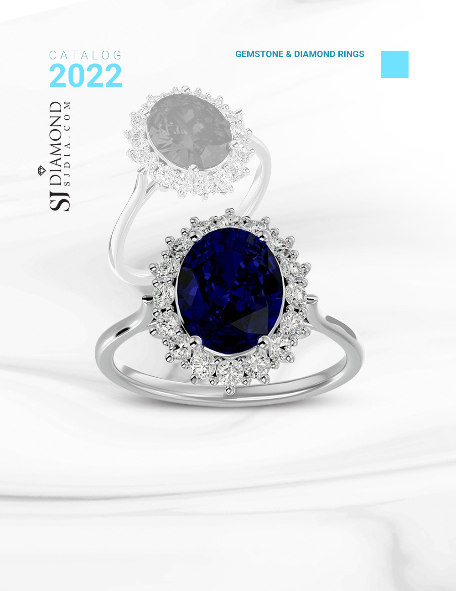
17
3.60 Carat Oval Shape Sapphire and Halo Diamond Ring In 14 Karat White Gold
Retail: $2,999.99
Our Price: $1,799.99
Style 52110

Slide 19
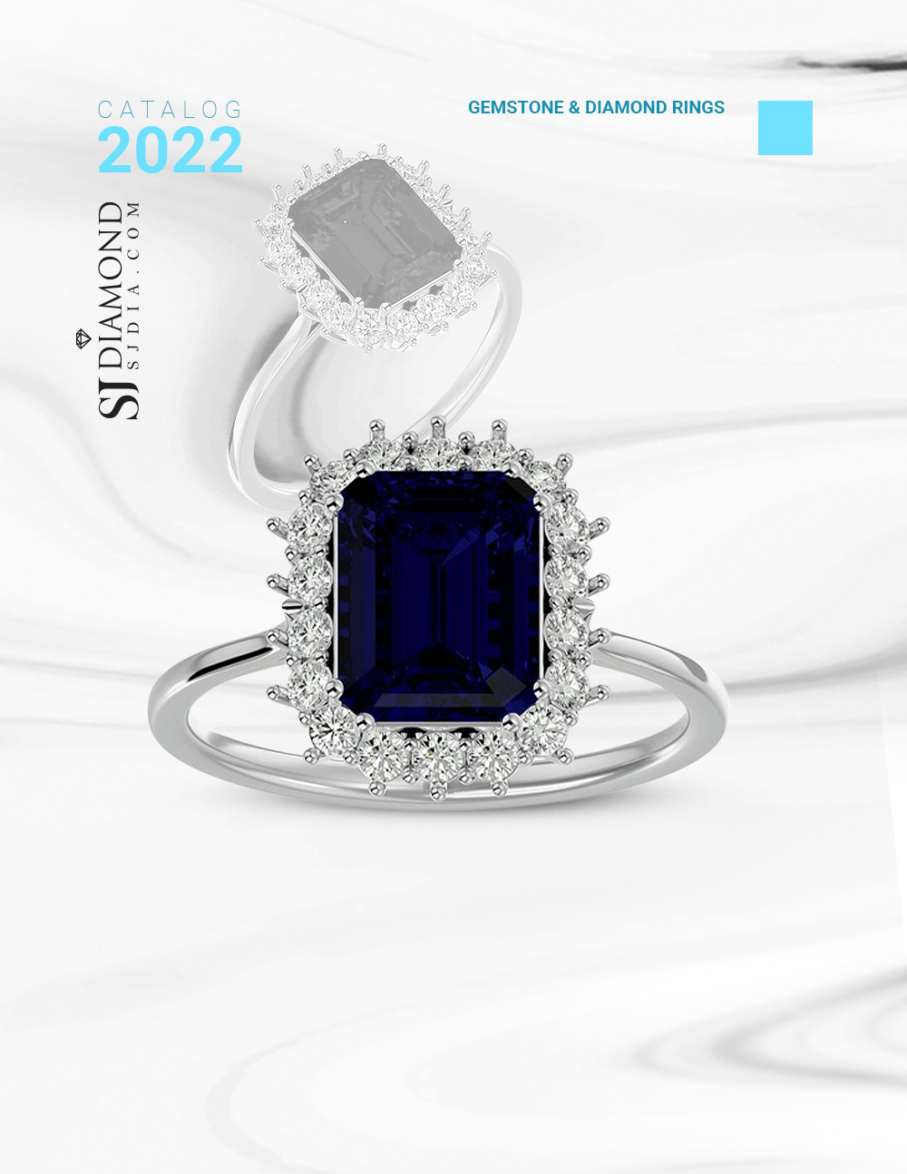
18
3 1/5 Carat Sapphire and Halo Diamond Ring In 14K White Gold
Retail: $2,999.99
Our Price: $1,699.99
Style 52026

Slide 20
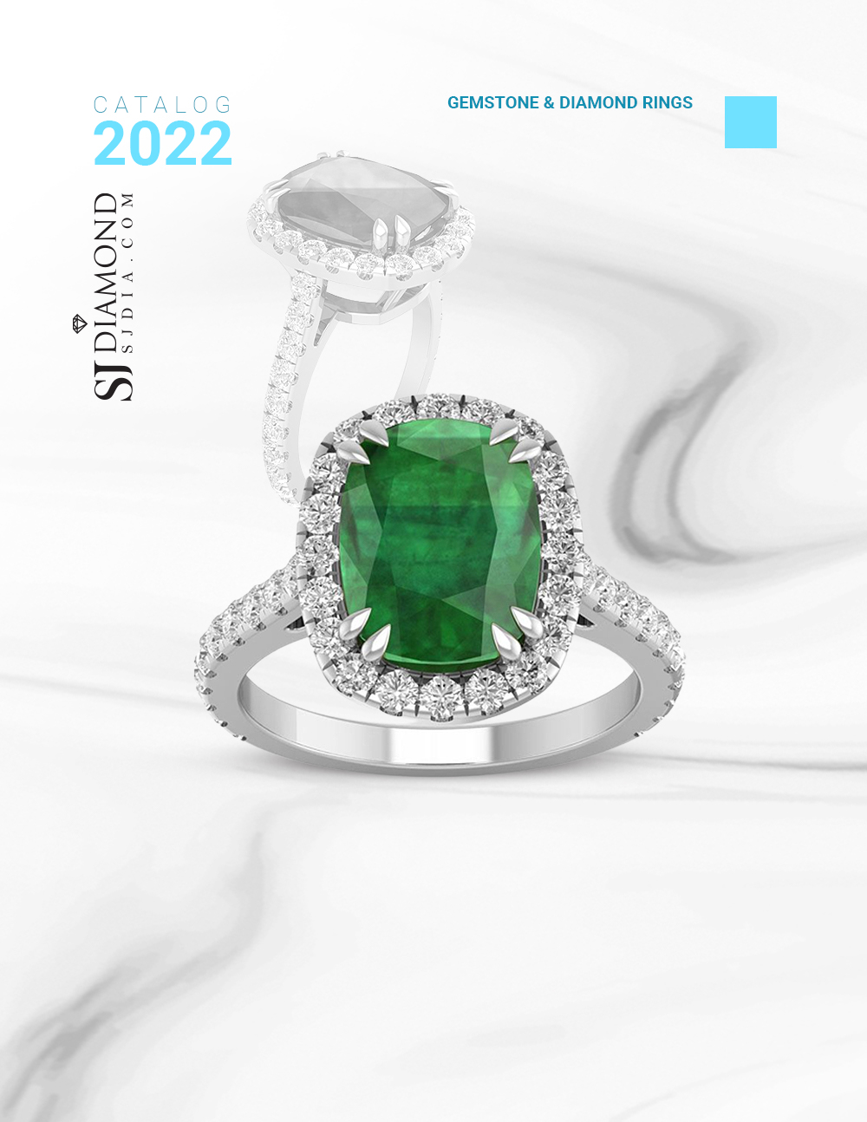
19
4 1/2 Carat Cushion Cut Zambian Emerald and Diamond Ring In 14 Karat White Gold
Retail: $9,999.99
Our Price: $4,999.99
Style 50964

Slide 21
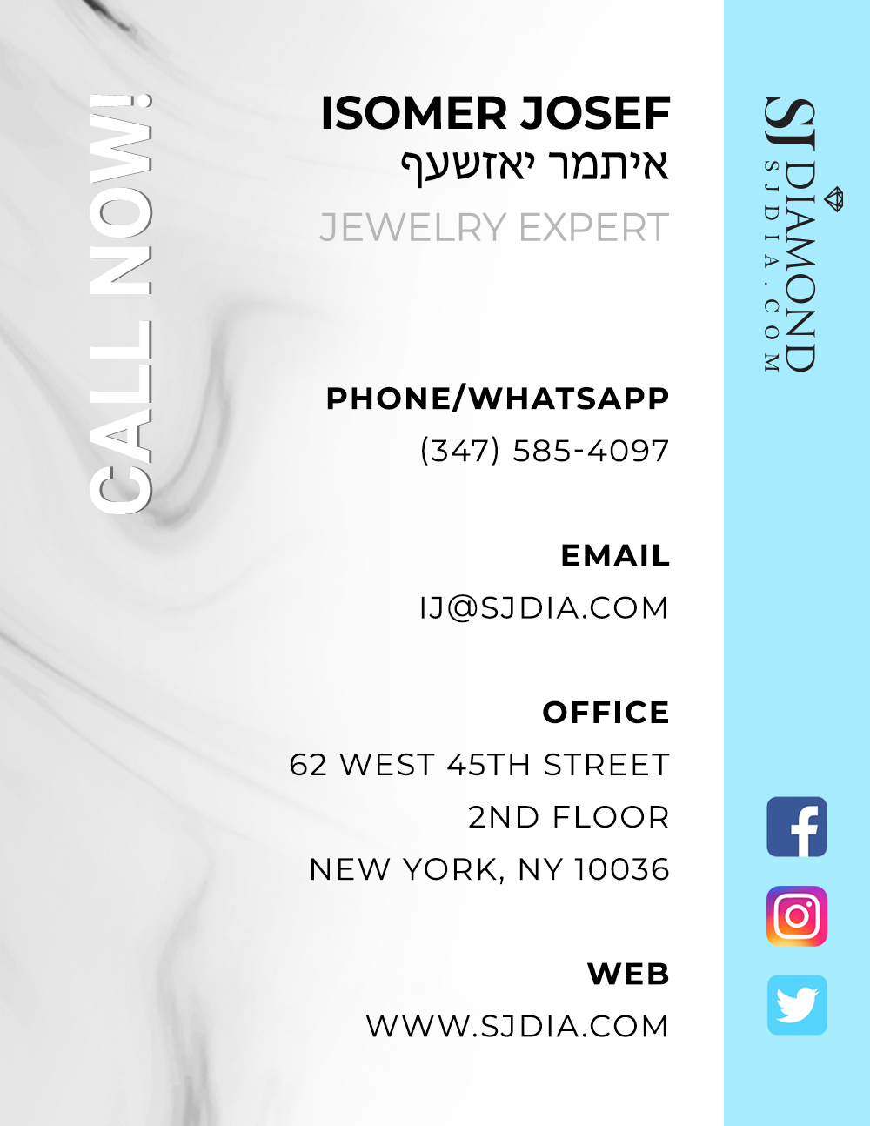

Slide 22
