Slide 2
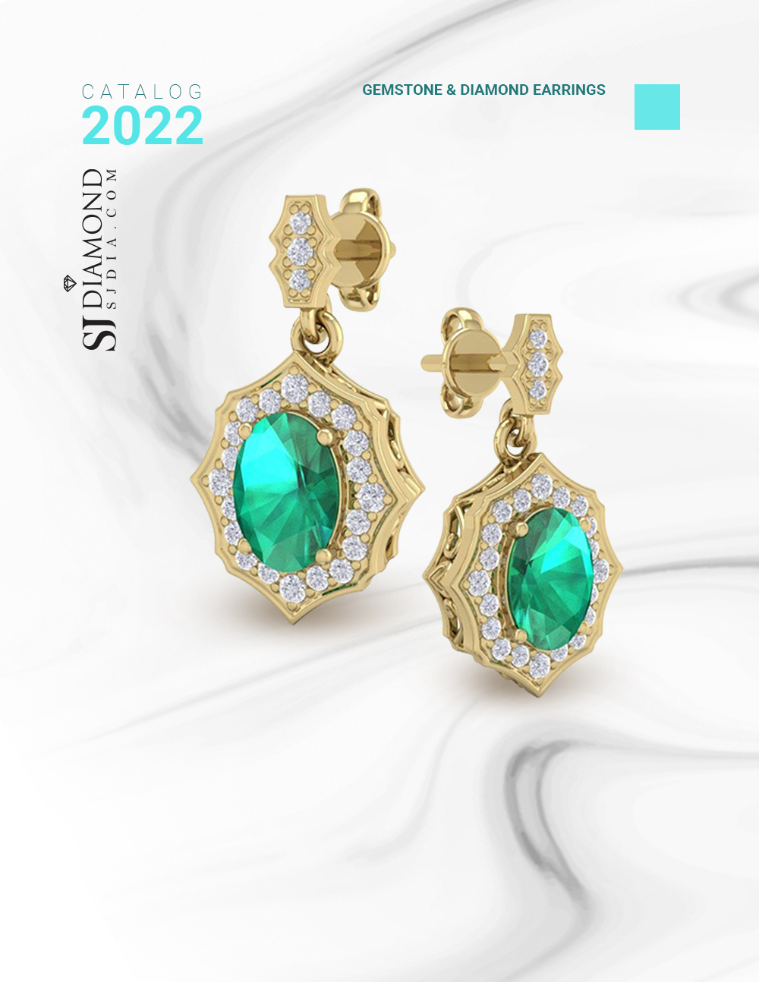
1
1 3/4 Carat Oval Shape Emerald and Diamond Dangle Earrings In 14 Karat Yellow Gold
Retail: $1,999.99
Our Price: $1,799.99
Style 47025

Slide 3
2
6 1/2ct Statement Style Sapphire and Diamond Earrings, 14k White Gold
Retail: $5,999.99
Our Price: $4,099.99
Style 3677

Slide 4
3
2 Carat Sapphire and Halo Diamond Dangle Earrings In 14 Karat Yellow Gold
Retail: $1,999.99
Our Price: $1,799.99
Style 25507

Slide 5
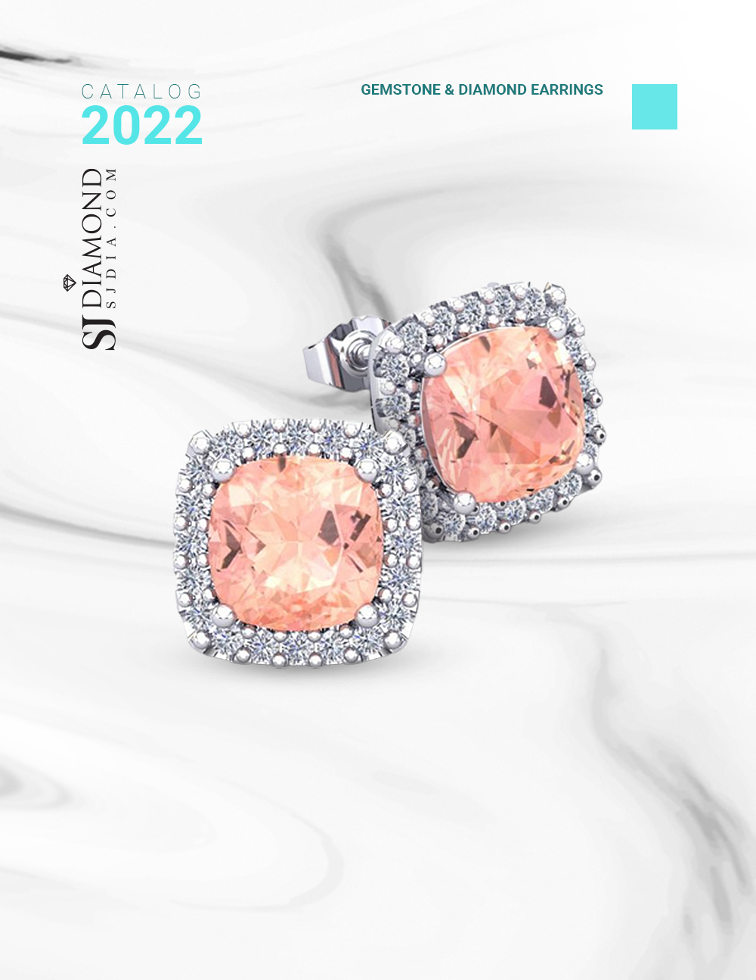
4
6 3/4 Carat Cushion Cut Morganite and Halo Diamond Stud Earrings In 14 Karat White Gold
Retail: $4,999.99
Our Price: $3,899.99
Style 25451

Slide 6
5
2 1/4 Carat Cushion Cut Tanzanite and Halo Diamond Stud Earrings In 14 Karat White Gold
Retail: $1,999.99
Our Price: $1,699.99
Style 25353

Slide 7
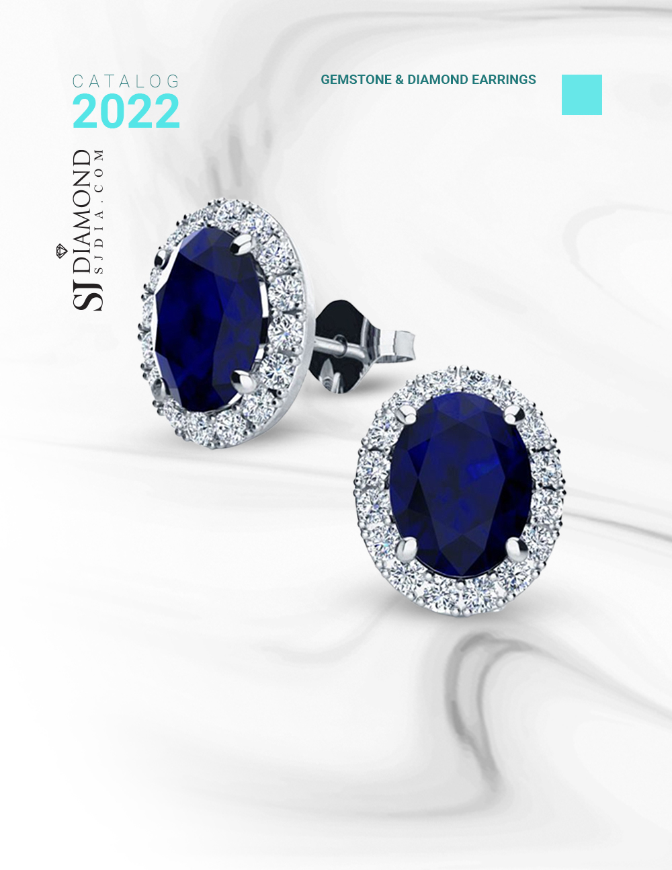
6
3 1/2 Carat Oval Shape Sapphire and Halo Diamond Stud Earrings
In 14 Karat White Gold
Retail: $3,999.99
Our Price: $2,599.99
Style 20103

Slide 8
7
5 1/2ct Sapphire and Diamond Earrings in 14k White Gold
Retail: $5,999.99
Our Price: $4,499.99
Style 6638

Slide 9
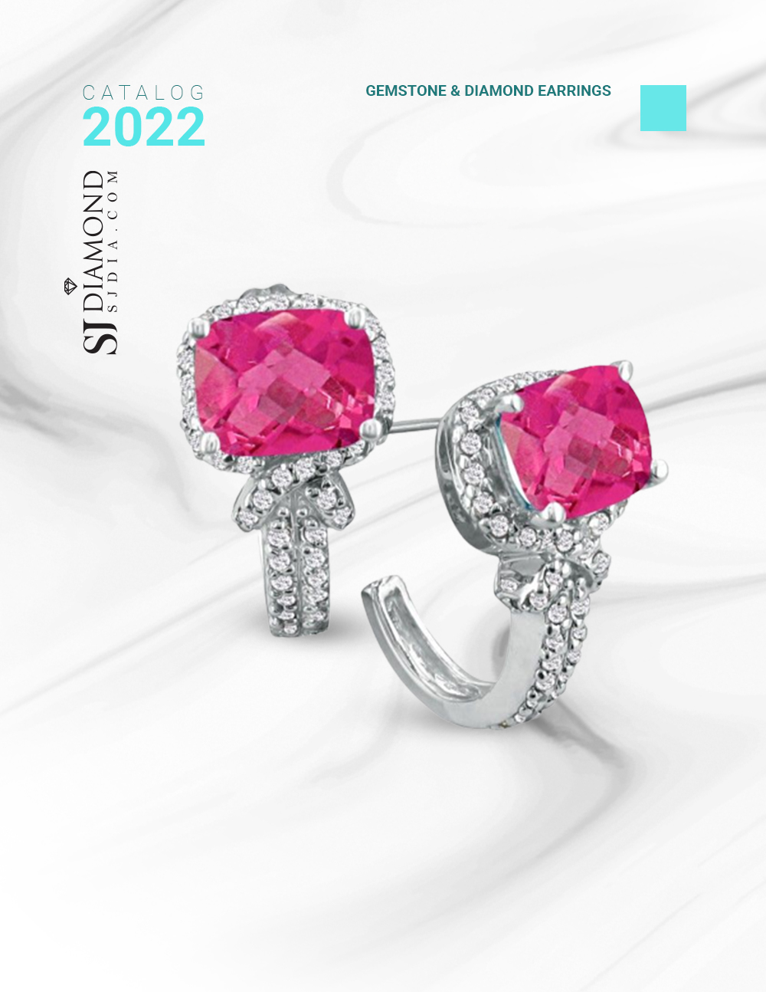
8
5 1/4ct Pink Topaz and Diamond Earrings in 14k White Gold
Retail: $1,999.99
Our Price: $1,599.99
Style 6617

Slide 10
9
2 1/2 Carat Oval Shape Ruby and Diamond Earrings In 14K Yellow Gold
Retail: $1,999.99
Our Price: $999.99
Style 60591

Slide 11
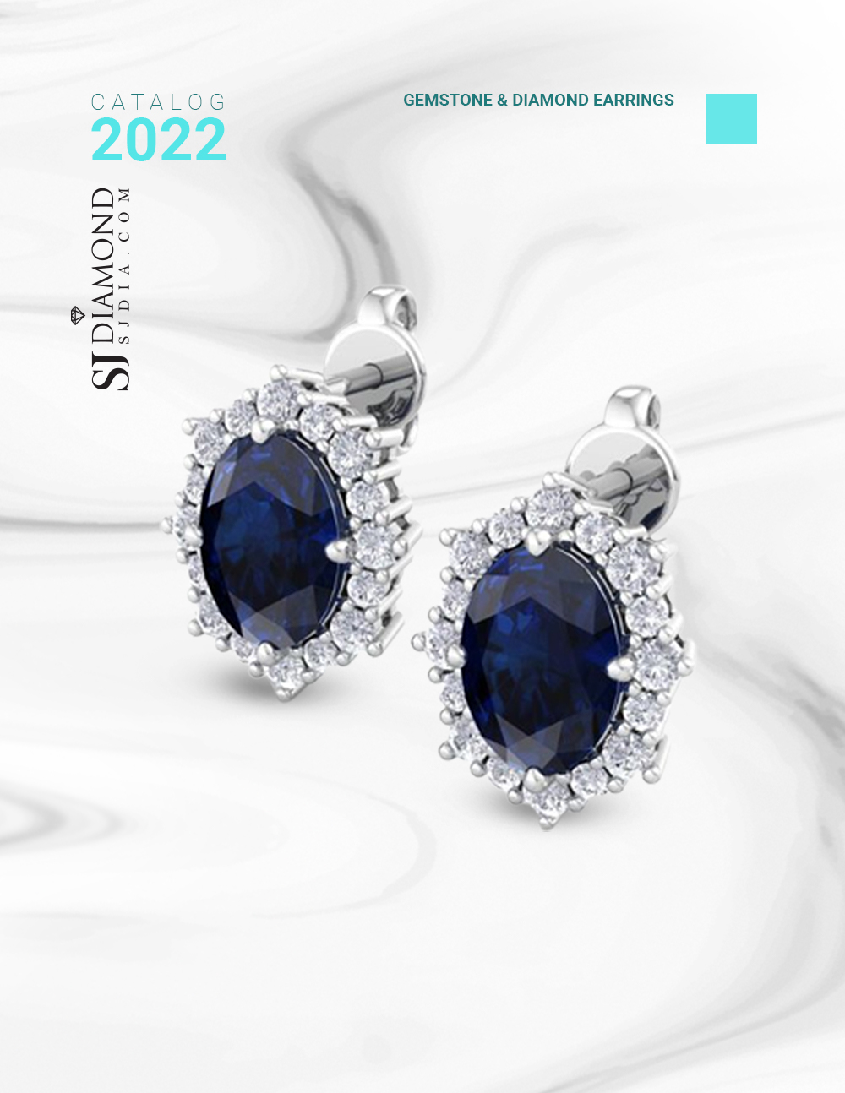
10
2 1/2 Carat Oval Shape Sapphire and Diamond Earrings In 14K White Gold
Retail: $1,999.99
Our Price: $999.99
Style 60476

Slide 12
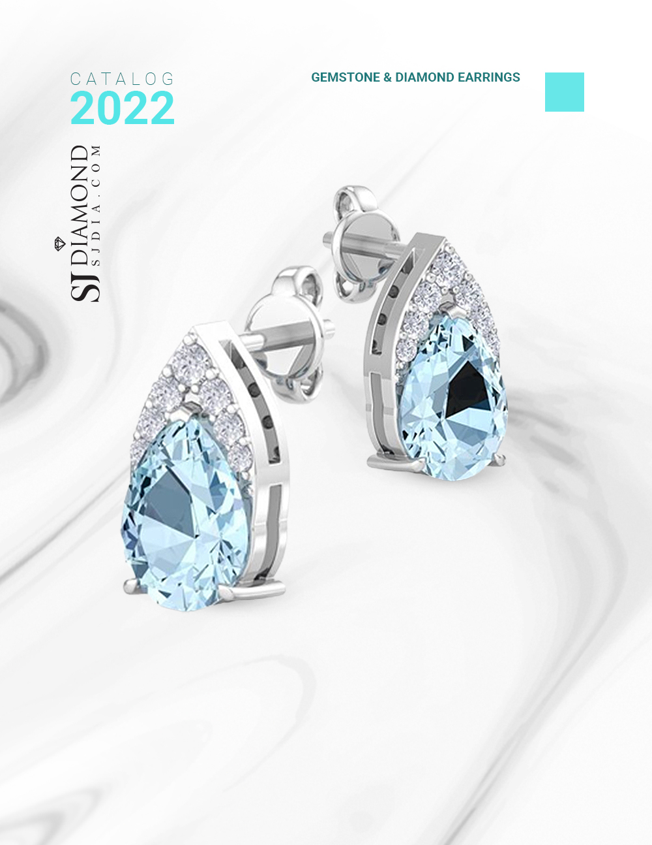
11
1 3/4 Carat Pear Shape Aquamarine and Diamond Earrings In 14 Karat White Gold
Retail: $699.99
Our Price: $499.99
Style 60122

Slide 13
12
2 3/4 Carat Tanzanite and Diamond Pear Shape Stud Earrings In 14 Karat White Gold
Retail: $1,999.99
Our Price: $1,299.99
Style 52684

Slide 14
13
2 1/2 Carat Oval Shape Ruby and Diamond Dangle Earrings In 14 Karat Yellow Gold
Retail: $1,999.99
Our Price: $1,399.99
Style 51052

Slide 15
14
2 Carat Sapphire and Diamond Hoop Earrings
In 14 Karat White Gold, 3/4 Inch
Retail: $3,999.99
Our Price: $2,899.99
Style 49196

Slide 16
15
7 Carat Sapphire and Diamond Hoop Earrings In 14 Karat Yellow Gold, 1 1/4 Inch
Retail: $9,999.99
Our Price: $8,899.99
Style 49064

Slide 17
